Slide 1
Planning your Airport Event
Ohio Aviation Association
2021 Annual Conference

Slide 2
Presentation Outline
Why do we hold events:
What kind of events might you want to hold?
Where on the airport can you hold events?
When do you need to start planning?
How do I get started?
Case Studies

Slide 3
WHY? Why do we hold events at our airports

Slide 4
Why do we hold events at our Airports
Enhance interest in Aviation/Publicity
Community relations
Economic Impact to community
Revenue for airport or charity
Fun ?

Slide 5
Airports can be unknown or unappreciated
3,304 airports in the US according to the NPIAS
Only 396 primary commercial service airports
General Aviation airports not often visible
GA airports can be perceived as unwelcoming
Important to Proactively engage the community to generate positive exposure and stimulate support

Slide 6
Engaging the Community
Get others to Help:
Chamber of Commerce
Economic Development
CAP/EAA Chapters
Local pilot Groups
Tourism/Visitors Bureau
Girl/ Boy Scouts

Slide 7
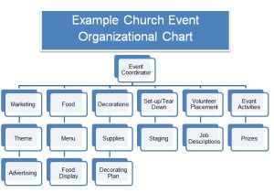
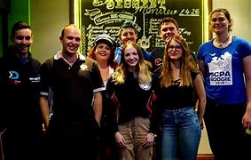
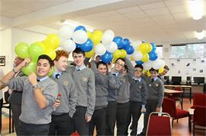
How – 11 months out
Committee Establishment
Budget – particularly Cash Flow
Volunteers
Air and Ground Operations
Volunteers
Exhibitors/Vendors
Safety/Layout Plan/Signage
Parking
Fly-In aircraft
Promotion/Sponsorship
Insurance

Slide 8
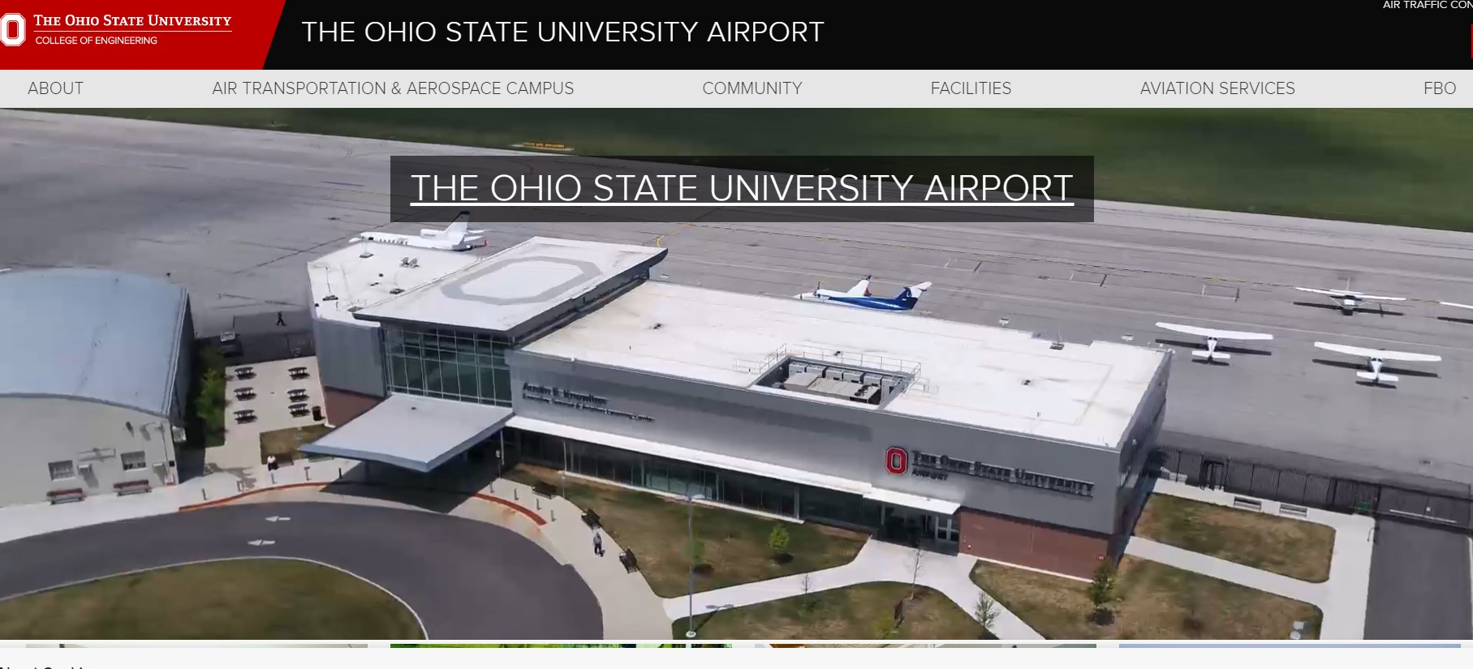
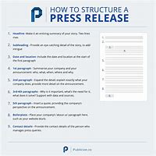
How – 10 months out
Marketing and Promotion
Aviation Calendar of Events
Especially OAA!
Regional EAA/AOPA Chapters
Public Service Announcements
Media contacts
Website

Slide 9
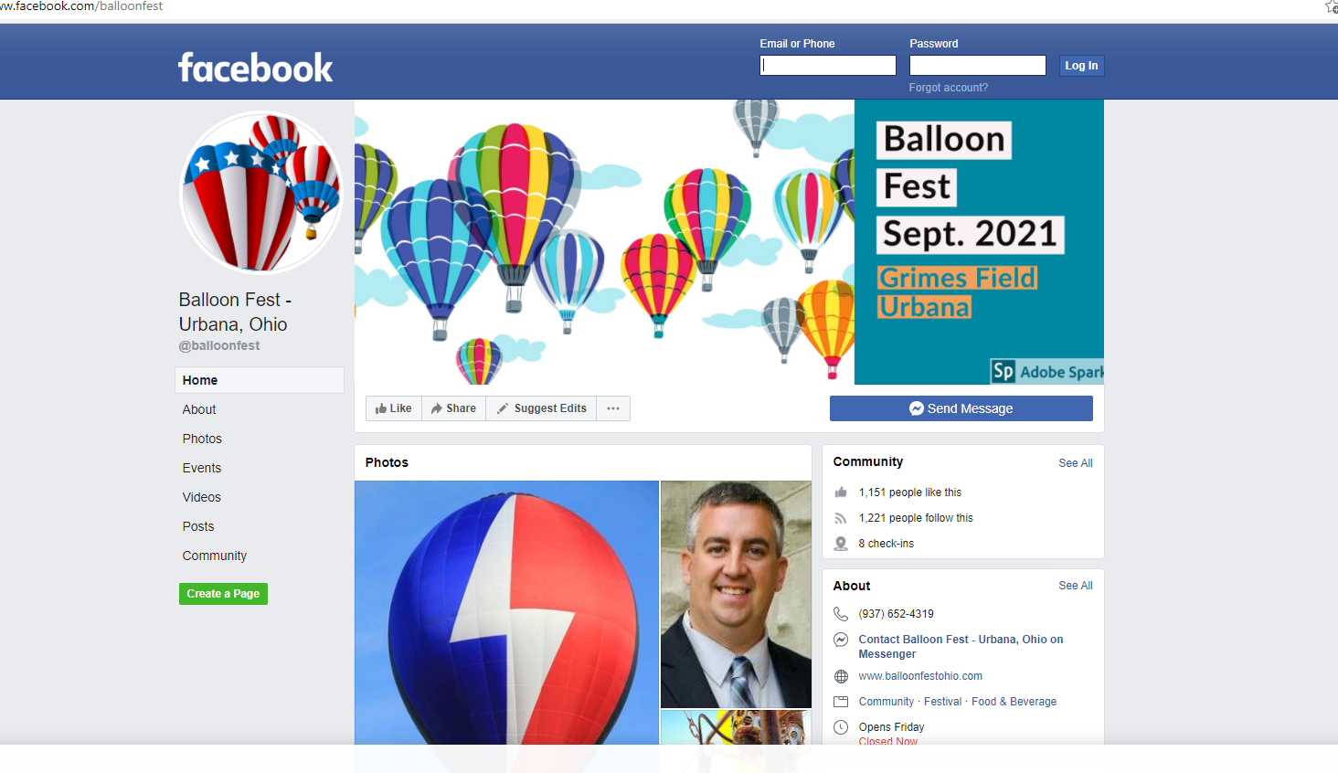
How – 10 months out
Hit a HOMERUN!
High quality Content
Often Updated
Minimal download time
Easy to use
Relevant
Unique
Netcentric

Slide 10
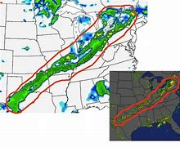
How – 9 months out
Contingency Plans
Weather
Financial Loss
Too much Success??
Ground Ops Plans
FAA Plans – Approvals, NOTAMS,

Slide 11
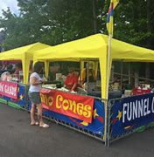
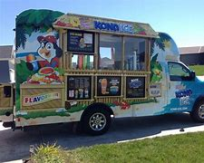
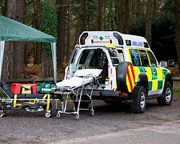
How – 8 months out
Accommodations
Concessions, Vendors, Fee Schedule
Security and Emergency Planning
Media Plan
Booths
Food Trucks

Slide 12
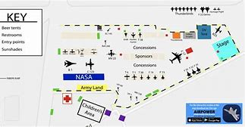
How – 7 months out
Layout Plan
Crowd Lines/Show Lines

Slide 13
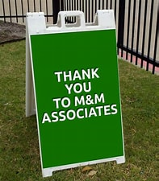
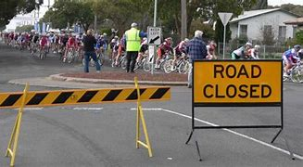
How – 6 months out
Signage
Volunteers
Support Facilities
Vehicle parking /Traffic

Slide 14
How – 5-2 months out
Special Invitations
Decision-makers
Media
Critics
Local, State and federal governmental officials
Civic Organizations
VIP passes, special seating, guided tours.

Slide 15
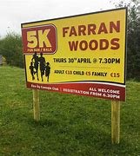
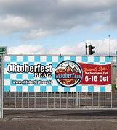
How – 1 months out
Review and Promote
Issue NOTAM prior to event

Slide 16
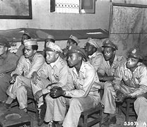
Let’s go, its 5 a.m., Day of – Danny Ocean
Event Phase
Briefings/meetings
Roll call
Introductions
Review NOTAMS
Communications
Okay, not as critical a mission – but a mission just the same! Directions, pep sessions, where to go for help! Execute and have fun!

Slide 17
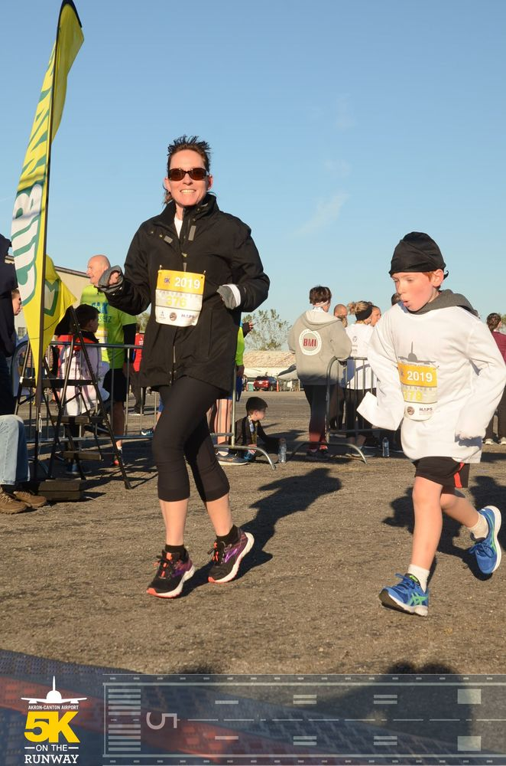
Have fun- Enjoy the day
Take pictures
Relax
Have fun! Be sure to enjoy the event – others will enjoy your enjoyment !

Slide 18
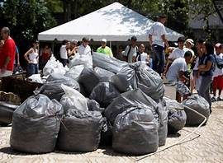
Day After
Clean -Up
Cancel NOTAMS
Resume Operations
Debrief/Analysis
Follow Up
Economic Impact Analysis

Slide 19
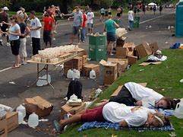
Day After
Rest a week, then begin again ☺

Slide 20
Case Studies

Slide 21
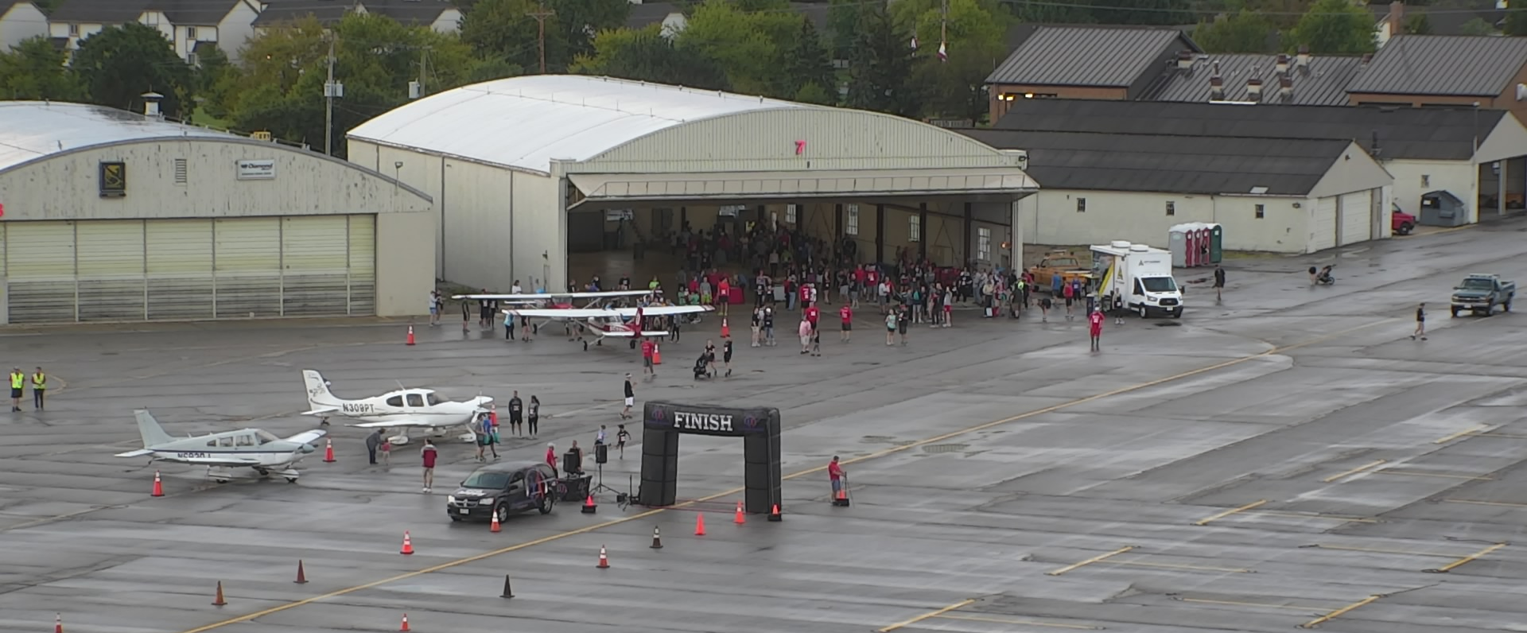
5K on the Runway

Slide 22
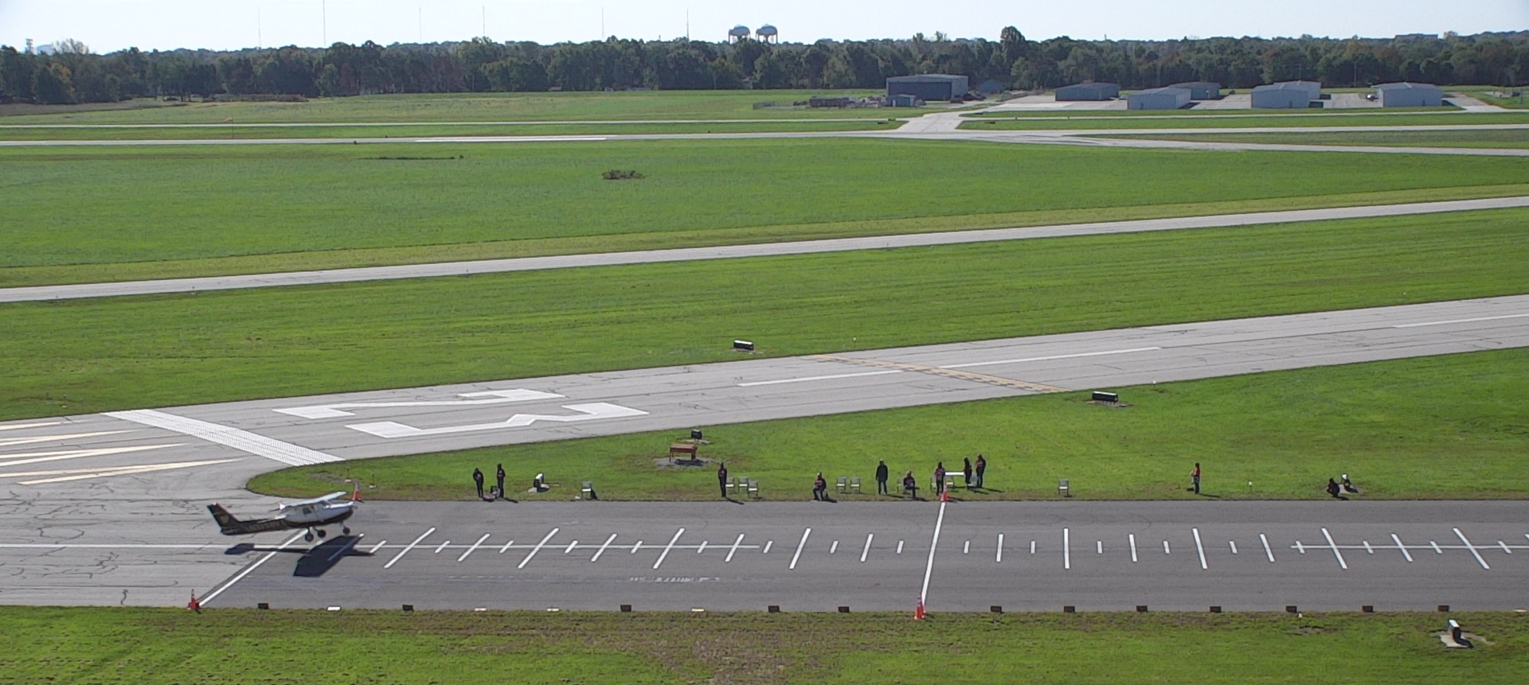
Safecon- Flight competition

Slide 23
Case Study
Parachute Jumpers

Slide 24
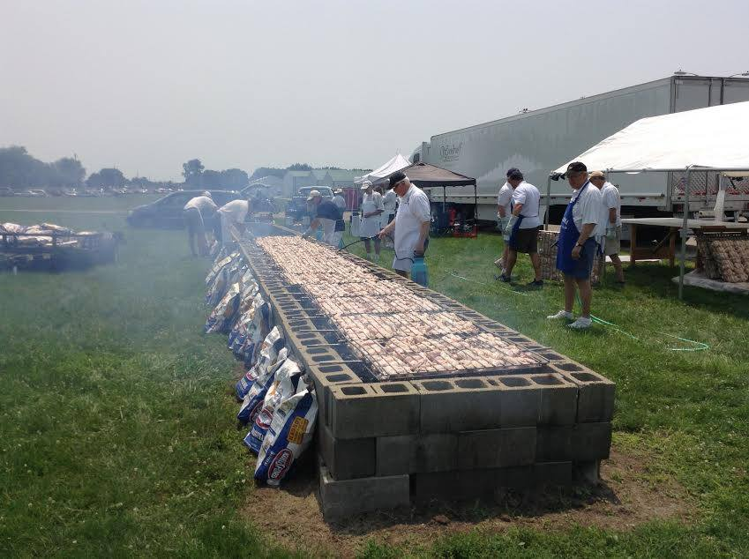
Airport BBQ

Slide 25
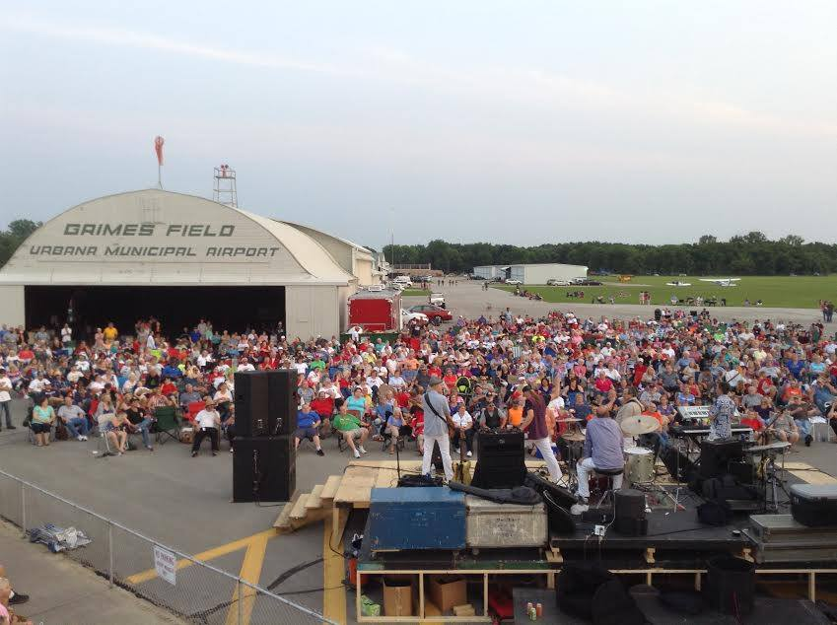
Community Concert

Slide 26
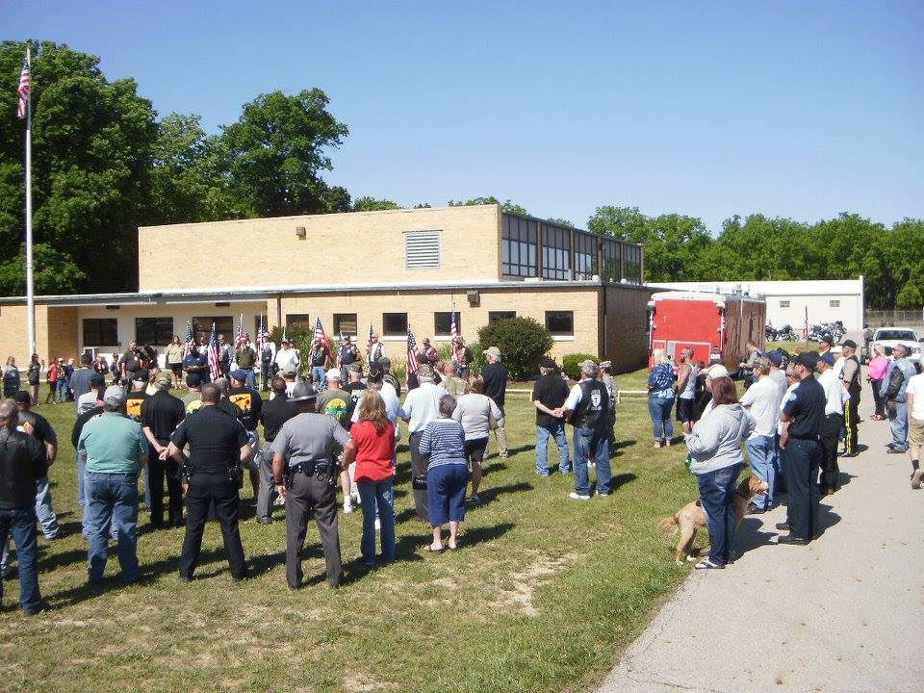
Commemoration- Veterans Wall

Slide 27
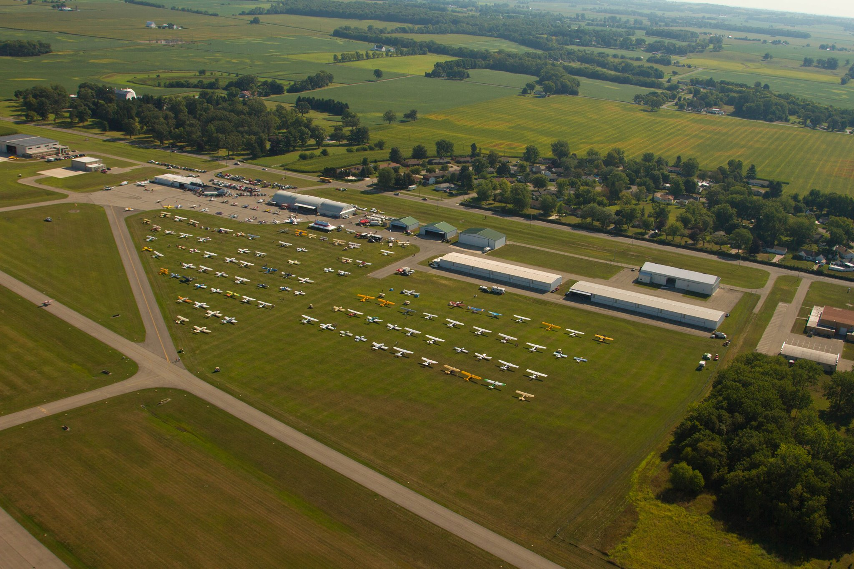
Airport Fly-In

Slide 28
Reference Materials
AOPA’s AIRPORT OPEN HOUSE GUIDE
ACRP Synthesis 41 – Conducting Aeronautical Special Events at Airports
FAA’s Many many resources
FAA’s National Aviation Event Safety Team
Airshows - Ground Operations Plans (faa.gov)

Slide 29
Thank you
Question & Answer

