Slide 1
In Turbulent Times!
OAA 2021:
Ohio Aviation Strong

Slide 2
M
m
M

Slide 3
That’s The Way We’ve Always Done It
M
m

Slide 4
CHANGE!
Why is change so threatening to many people?

Slide 5
CULTURE = past ENVIRONMENT = static CLIMATE = constant change

Slide 6
CLIMATE CREATION:
Creative aviation professionals MUST create conditions amenable for creativity and innovation to flourish!

Slide 7
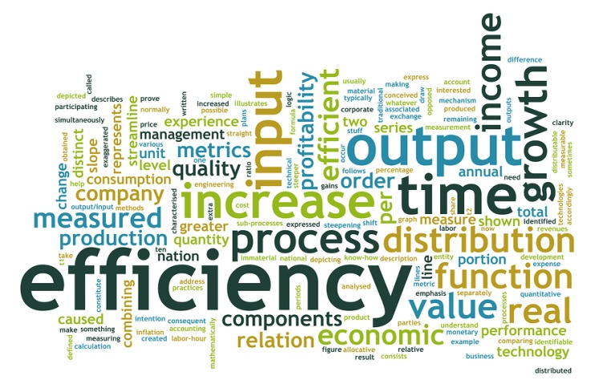
Most organizations are designed for efficiency NOT creativity/innovation!
versus

Slide 8
CHANGE!
Why is change so threatening to many people?
How can we help break “TTWWADI” thinking?
What motivates people to move out of their comfort zone?
© 2021 Coloring Outside the Lines
www.coloringoutsidethelines.com

Slide 10
V
A
L
U
E
C
O
S
T

Slide 11
In turbulent times, it’s all about…
perspective

Slide 12
The “Harvey Principle”
FROM: Coloring Outside the Lines:
“Learn to see invisible opportunities where other people see only visible limitations”
Jeff Tobe

Slide 13
From every challenge comes an opportunity
It’s all about perspective
Give yourself an A.S.K. (Alternative Solution Kick)

Slide 14
It’s all about the “experience”

Slide 15
Are you Prepared to Make the Leap?
Customer
Service
Customer
EXPERIENCE
Satisfied
Customers
LOYAL / ENGAGED
Customers

Slide 16
It’s all about perspective
Give yourself an A.S.K. (Alternative Solution Kick)
Shatter the stereotype of the experience customers EXPECT to have with you!

Slide 17
What is the…
(fill in the name of
your airport/organization here)
EXPERIENCE??

Slide 18
What is the…
(fill in YOUR NAME here)
EXPERIENCE???

Slide 19
Every interaction with your customers cannot NOT be an experience!
How RANDOM or how MANAGED is the aviation experience you are delivering?

Slide 20
TEN POINT CUSTOMER FRAMEWORK
1. Strategic Drivers
2. Customer Segmentation
3. Customer Engagement
4. Employee Engagement
5. Training & Tools
6. Process Orientation
7. Joint Workouts
Capacity for Change
Consequences
Committed Leadership

Slide 21
M
M
M
M
m

Slide 22
To INFLUENCE customer experience, consider every one of your people’s touch points!
Touch Point = “any opportunity we have to INFLUENCE the customer experience”

Slide 23
Need to exercise our “RISK” muscles!!
We need to take the risks that come with turbulence.
“We cannot solve our problems by using the same kind of thinking we used when we created them.” Albert Einstein

Slide 24
Need to exercise our “RISK” muscles!!
“Coloring Outside the Lines is scary business…”

