Slide 1
JobsOhio
Update

Slide 2

Ohio’s Private Economic Development Corporation
Stable Funding
Private Structure
Statewide Coverage

Slide 3
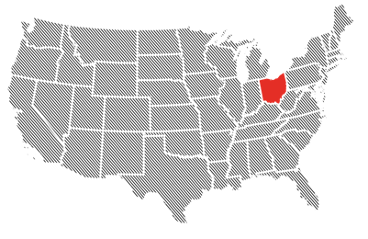


Generational Opportunity
Growing Recognition
Gov Response to Crisis – Ohio Stood Out!
Business Climate
Business Climate
Leadership Position
#1 Governor’s Cup
#3 Business Climate
#4 Prosperity Cup
#6 Business Opportunity
#7 Best for Business
#9 Best for Business
#10 Top for Business
Business Climate

Slide 4

Generational Opportunity
Ohio Emerging Strong
Leadership Position
Business Climate
Moody’s return pre-Covid economic conditions
Venture Capital record year
More than Indiana & Michigan combined
Record new biz filings
AA-plus Financial Rating
Highest rating for Ohio since 1979

Slide 5
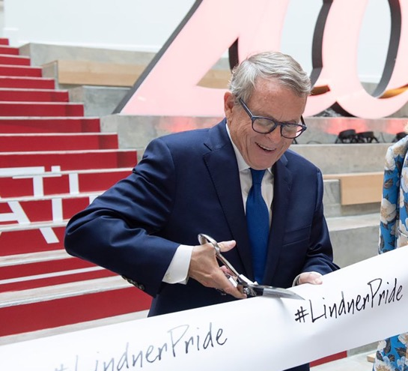
Generational Opportunity
New business – all metrics UP year over year
% Increase from 2019 to 2021
  54%+
  112%+
  127%+
  181%+
  Projects
  New Jobs
  New Payroll
  New Capex
Leadership Position
Business Climate
86
Net Promoter (Kroger 60-70)

Slide 6
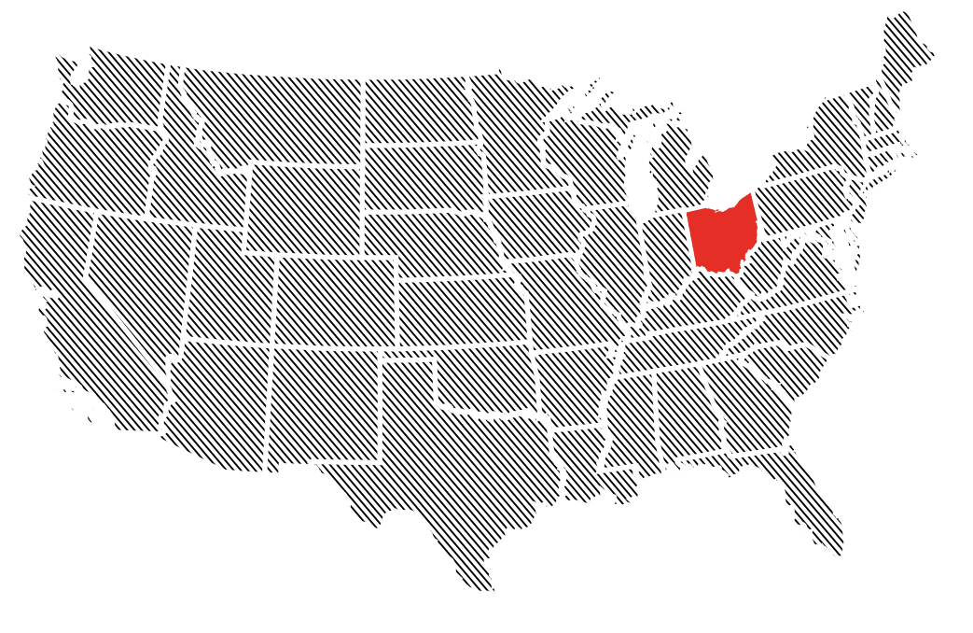
Ohio Is Investing
5-Year Outlook
Looking Ahead
  Ohio IS INVESTING
Q4, 2019
10
Economic Sectors
Leadership Position
JobsOhio Sectors
1 | Advanced Manufacturing
2 | Logistics & Distribution
3 | Financial Services
4 | Automotive
5 | Information Technology
6 | Military & Federal
7 | Energy & Chemicals
8 | Healthcare
9 | Food Processing & Agro
10 | Aerospace & Aviation
Loans, Grants
$15.5B+
Marketing Ohio
Total Investment JobsOhio and other
Total Jobs: | 1.2M

Slide 7
Air Service Restoration

Slide 8



JobsOhio Key Initiatives and Priorities
1.0
2011 –
2020 –
2020 –
JobsOhio
2.0
2.X
JobsOhio
JobsOhio
Talent
10
COVID PPE
Sites
COVID Response
Innovation
9
10
Diversity, Equity & Inclusion
Ohio PPE Leadership
Stakeholder Engagement
Ohio To Work™
Sectors
Mil/Fed
Inclusive Econ Dev
Broadband
Find it Here + Find Your Ohio
Ohio is for Leaders
Air Service Restoration
Econ Dev Programs
Enhanced Lending Support
13
JO Future of Work

Slide 9
Why an Air Service revenue guarantee program?
Access to Service Matters
Ohioan's work at Airports
20 Years of Decline
Generational Opportunity
Doing Our Part
Business told us they needed air service to expand, relocate to Ohio and in some cases stay in Ohio
Ohio air service decline has been greater in the last 20 years relative to other states in the Midwest
COVID has impacted air service nationwide and provides generational opportunity to attract air service ahead of other states with a restoration program
JobsOhio Board approved funding in June 2020 for up to $10 million in the current fiscal year

Slide 10
Scheduled Seats per Day Each Way at Ohio Airports
2005 through 2019
In the 15 Year Period from 2005 through 2019, Seat Capacity at All Ohio Airports Declined 42.7%; Excluding Cincinnati, Seat Capacity Declined 17.0%

Slide 11
Scheduled Seats per Day Each Way at Ohio Airports
2005 through YTD September 2021
Versus Full Year 2019, Capacity through September 2021 Is down 30.2% at
All Ohio Airports and down 32.2% at All Ohio Airports Excluding Cincinnati

Slide 12
Scheduled Seats per Day Each Way at Ohio Airports
June-September 2019 and June-September 2021
Total Capacity at Ohio Airports in the Period from June-September 2021 Is down 20.9% Versus June-September 2019

Slide 13
Total U.S. Capacity Is down 15.1% from June through September 2021
Versus June through September 2019; Ohio Capacity Is down 20.9%

Slide 14
Cities Discontinued from Ohio Airports
September 2019 to September 2021
Airports in Ohio Have Lost All Service to a Total of 30 Cities since September 2019

Slide 15
Discontinued Routes by Airline at Ohio Airports
September 2019 to September 2021
Airlines Have Discontinued 63 Routes from Ohio Airports since September 2019

Slide 16
Ohio’s Airports Have Gained New Service to a Total of 18 Cities since September 2019
New Cities Served from Ohio Airports
September 2019 to September 2021

Slide 17
Discontinued and New Routes by Airline
September 2019 to September 2021
Legacy/Network Carriers Have Added Six New Routes since September 2019;
Low-Cost and Ultra Low-Cost Carriers Have Added 31 New Routes

Slide 18
New Routes by Airline at Ohio Airports
September 2019 to September 2021
Airlines Have Added 37 New Routes from Airports in Ohio since September 2019

Slide 19
UPDATED
Ohio Air Service Opportunities
+341,164 seats
Breakdown of financial support on 12 Routes
$2.2M Community Financial Support
$5.1M
JobsOhio Support
$180M
Total Economic Impact from
12 new routes
$36.5M
Airline Revenue
1:8
Leverage of JO Funds to Others
+2.9%
Annual Capacity
Based on March 2021 Capacity

Slide 20
The Ohio Site Inventory Program (OSIP)
The Ohio Site Inventory Program (OSIP)

Slide 21




Sites and Inclusion Programming
JobsOhio offers multiple initiatives related to site and building development, all with the shared
goal of encouraging job creation and capital investment within our state.
Site Selection
Real Estate Development
Community Readiness
Property Database
Revitalization
Site Inventory Program
OHSE Sites Initiative
Inclusive Growth Strategy*

Slide 22
Site Inventory Program (OSIP) Overview
Grants and low-interest loans to support near-term speculative site and building development and complement new JO Sector initiatives, i.e. reshoring
Primary goals of the program:
Fill gaps in Ohio’s inventory with real estate targeting near-term sector wins
Mitigate developer risks preventing product development
Accelerate the process of bringing in-demand product online to support “growth” sectors and JobsOhio initiatives
JobsOhio seeks a diverse portfolio* of inventory such as:
Sites and buildings, small, medium and large in size
Office, R&D, manufacturing, warehousing and distribution
Urban, suburban and rural
*Developed product must align with the JobsOhio targeted industry sectors identified as “growth” sectors
Notes:
Other Key Components:
A lead development entity (i.e. Community, port authority, private developer, etc.) should be identified
Loans typically support new construction
Grants typically support costs associated with items such as demolition, environmental remediation, building renovations, site preparation, and infrastructure improvements
A concise marketing program describing how the new site or building will be successfully occupied or win a project within 120 days of completion

Slide 23
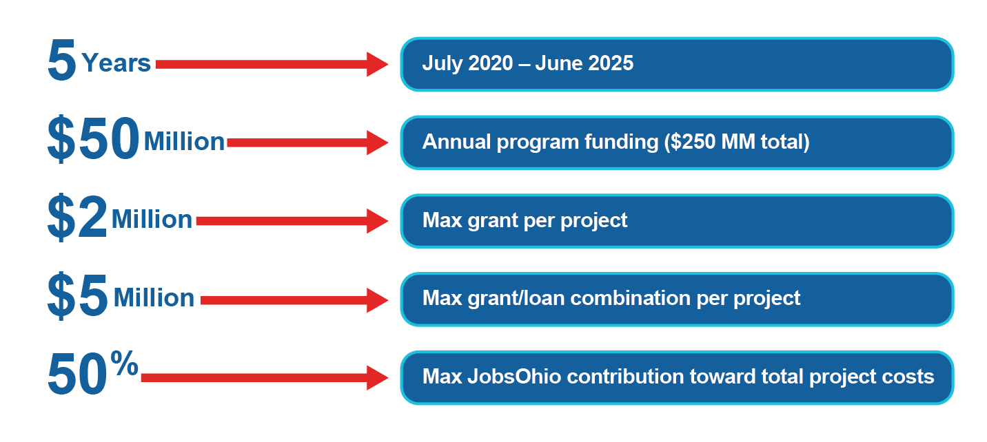
OSIP Program Details
Program funding accounts for a combination of grants and loans, which would be made available to fill identified funding gaps and be used as a development accelerator.

Slide 24



OSIP 3 Key Components
Speculative
Site/Building Development
Professional
Studies
Improved
Air Facilities
Sites
Buildings
Targeting growth sectors
Supporting new JO initiatives, e.g. reshoring
Grants/loans to applicants
Preliminary engineering due diligence
Real estate market assessments
Economic impact analysis
Direct contracting between JobsOhio and vendors
Airport infrastructure
Aviation facilities
Utilizes both speculative development and professional studies components
JobsOhio has identified these opportunities for the state in fast-growth sectors and new JobsOhio initiatives. Applicants should align proposals with these opportunities.
Notes:
This program was established to create property within the state not being developed by the market but with a proven demand and known economic benefit near term.

Slide 25
OSIP Guiding Principles
Projects will be evaluated based on the following guiding principles:
REQUIRED
STRONGLY PREFERRED
PRIORITIZED
Identified end-user targets
A Phase I ESA must be completed
A Phase II ESA must be completed if the Phase I recommends it
Diverse, statewide portfolio focus on near-term opportunities
Experienced development partner
30+ acres for site development (no proposed building)
Loans support new building construction
JobsOhio will prioritize speculative development projects based on alignment with JO priorities
Brownfield redevelopment projects likely to receive more favorable support
Focus is on filling known/proven inventory gaps within JobsOhio targeted industry sectors
Notes:
This program was established to create property within the state not being developed by the market but with a proven demand and known economic benefit near term.

Slide 26
OSIP Eligible Applicants/Ownership
Eligible Applicants
Businesses
Ownership/Control
Applicant must have ownership/control of the property, or
Beneficiary
Cannot be the contaminator of environmental issues, if such exist
Private Developers
Non-profits
Port Authorities
Local Governments
Option/development agreement with a cooperative landowner
Notes:
This program was established to create property within the state not being developed by the market but with a proven demand and known economic benefit near term.

Slide 27
OSIP Use of Funds 2020-21
OSIP Total Annual Funding (July 1, 2020 - June 30, 2021) | $ 50,000,000
- Inclusive Growth Strategy (excluding JOIG / 1.0 projects) | $ (6,000,000)
- Airport Strategy (approx.) | $ (5,000,000)
- OSIP Due Diligence | $ (908,175)
BALANCE REMAINING FOR OSIP SPEC DEV. PROJECTS | $ 38,091,825

Slide 28


OSIP End Uses
Developed Property must be suitable for an eligible end user aligned with a JobsOhio targeted industry sector.
ELIGIBLE
INELIGIBLE
Industrial
(light to heavy sites, parks, and buildings)
Warehousing/Distribution
(sites and buildings)
Office Buildings*
(preference for downtown/urban core)
Aerospace & Aviation Hangars (support MRO and Aerospace Manufacturing)
Recreational Parks
Residential
Retail
Hotels
Hospitals
Parking Garages / Parking Lots
Entertainment venues
*For mixed use office, ineligible components such as retail/residential should not exceed 20% of total square footage

Slide 29
OSIP Speculative Development Costs
ELIGIBLE
Special Considerations
Administrative or general project management costs
Engineering Services, Planning fees & material costs, other relevant professional fees
Parking lots (only when used as an environmental control)
Building/land
acquisition costs
Site Preparation
New Building Construction
Infrastructure (on/off-site utilities, roads, rail, docks, etc.)
Redevelopment Project eligible costs
  Demolition
  Environmental Remediation, Testing, Lab Fees, Certified Professional Fees, Asbestos & Lead Paint Abatement
  Building Renovation
  Removal & Disposal of Universal and Construction Waste)
*For mixed use office, ineligible components such as retail/residential should not exceed 20% of total square footage

Slide 30
OSIP 5-Year Metric Outcomes
Program Description | Grants and loans for near-term speculative development and projects targeting “growth” Sector projects and new JO initiatives
Success Metrics | 3X - 10X Leverage co-investment Strategic, actionable development plan, with strong, commercial or federal market growth opportunity | Site plans should be reaching 50% - 80% completion, including identification of potential outside funding sources
Support | Grants up to $2 million, and grant/loan combination awards up to $5 million for speculative development projects. Directly contracted engineering due diligence support for sites seeking SiteOhio Authentication.
5-year KPI’s | 20 - 35, new, authenticated sites 50 new sites and buildings 5 Airport projects | 10 - 20 new, significant deals 6,000 – 10,000 new and retained jobs
5-year Budget | $50 Million/year JobsOhio Investment ($250 Million total)

Slide 31
OSIP – Case Studies

Slide 32
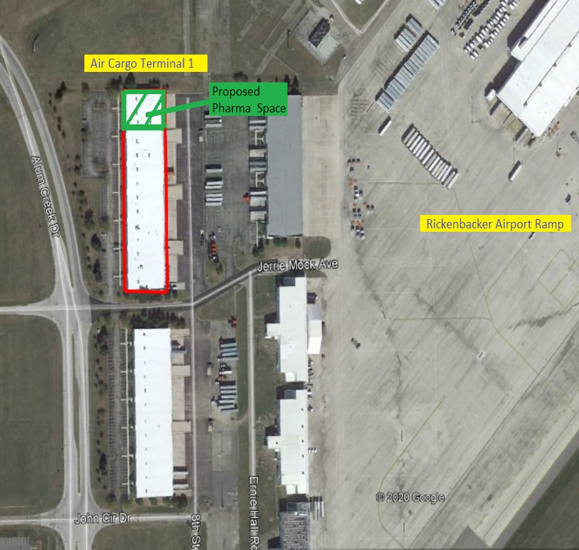
Rickenbacker Cold Storage Project
  Project
  Columbus Regional Airport Authority will redevelop cargo terminal space for the handling of temperature sensitive pharmaceutical shipments. The project will involve demolition and reorganizing three existing suites to create at least 9,600 square feet of warehouse with temperature-controlled zones. This will be Ohio's first dedicated handling facility for temperature controlled pharmaceutical air cargo shipments.
  OSIP Support
  Total Project Investment: $1,426,810
  OSIP Grant: $600,000
  Partners
  One Columbus
  Columbus Regional Airport Authority

Slide 33

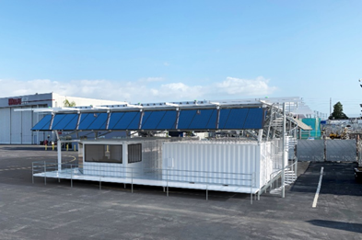
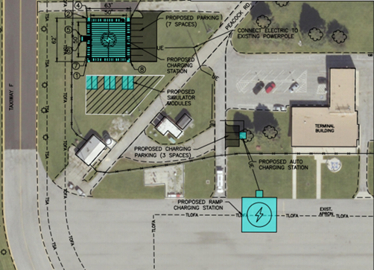
Springfield eVTOL Infrastructure Project
  Project
  The City of Springfield will complete site preparation, utility extensions, provide new access drive, and parking area to accommodate charging stations associated with the City of Springfield office pods in support of eVTOL Agility Prime strategy. As part of the project, they will complete the construction of elevated charging stations.
  OSIP Support
  Total Project Investment: $1,226,105
  OSIP Grant: $226,105
  Partners
  Dayton Development Coalition
  City of Springfield

Slide 34
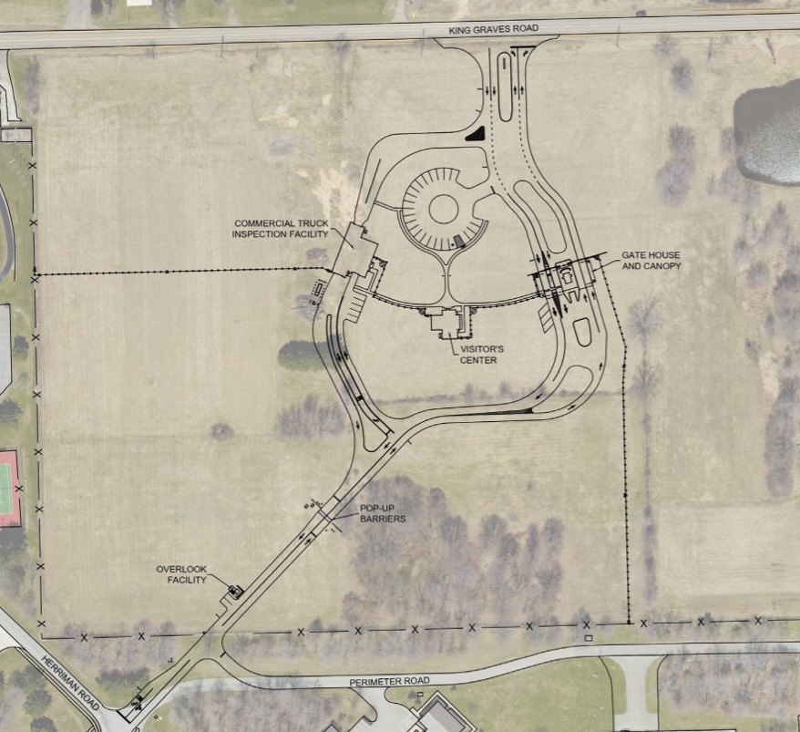
Youngstown ARS Security Improvements
  Project
  The Western Reserve Port Authority (WRPA) will acquire land from James Alderman. Once the acquisition has been completed, WRPA will transfer the land to the Youngstown Air Reserve Station (YARS). This transfer will facilitate the relocation and upgraded secure entrance to YARS. Once acquired, the 910AW will relocate its existing main entrance gate at YARS to the Alderman property that will serve as the primary means of ingress and egress for installation personnel and would serve limited commercial traffic.
  OSIP Support
  Total Project Investment: $8,690,951
  OSIP Grant: $250,000
  Partners
  Team NEO
  Western Reserve Port Authority

Slide 35
Diversity, Equity & Inclusion Strategy
35
Notes:
Maybe mention your East Cleveland tour to connect w/the image
East Cleveland was our first pilot project for one of the inclusion programs. We are providing economic development planning support to assist in the re-development one of their sites and working with them on an application for funding to get broadband extended into the city.
Distressed cities like East Cleveland don’t always have the economic development resources or technical expertise to advance a deal or a project – our pre-project planning support program for distressed cities is designed to help them get over the hurdles.
First started working on the inclusion strategy last year, introduced concepts to board in November.

Slide 36


Inclusion Strategy Overview
JobsOhio’s Economic Development Inclusion Strategy strives to attract capital, create jobs and grow talent for all Ohioans.
Primary goals of the strategy:
Drive investment and job creation
into distressed areas across Ohio
Help grow small and medium-sized businesses that are located in distressed communities and/or are owned by an underrepresented population
Defining Inclusion:
Geographic Distress rural and urban areas based on poverty and other key economic indicators
Underrepresented Populations including consideration of race, ethnicity, gender, veterans and the disabled
Notes:
JobsOhio’s economic development inclusion strategy is a new initiative; part of our 5-year go forward strategy
Goal of the initiative is to help lift the people and places across Ohio that have been “left-behind” – both distressed areas and underrepresented population
Seek to drive investment & job creation into these distressed areas and help support growth of smaller businesses that previously couldn’t access JobsOhio programs because their company or project was too small to benefit
20% of OH pop lives in distressed areas (2.2M people; including urban & distressed areas)
Ohio cannot achieve our economic goals unless we do something to accelerate growth among these distressed areas -- they also represent a tremendous opportunity for us to tap additional resources – people sites/facilities within those areas
Underrepresented populations includes minority, female, veteran and disability-owned businesses.

Slide 37

JobsOhio Diversity & Inclusion Programs
The Inclusion Strategy includes three new programs:
1.
Pre-Project
Planning Support
Planning and technical assistance to help advance development projects
2.
Vibrant Community Grant Program
Grant funding for catalytic development projects
3.
JobsOhio Inclusion Grant (JOIG)
Grants for small companies expanding in distressed areas or owned by an underrepresented population
FOR DISTRESSED COMMUNITIES
FOR SMALL BUSINESSES
Inclusion metrics across all JobsOhio programs
to measure ongoing participation and impact

Slide 38
JobsOhio Inclusion Grant (JOIG)

Slide 39
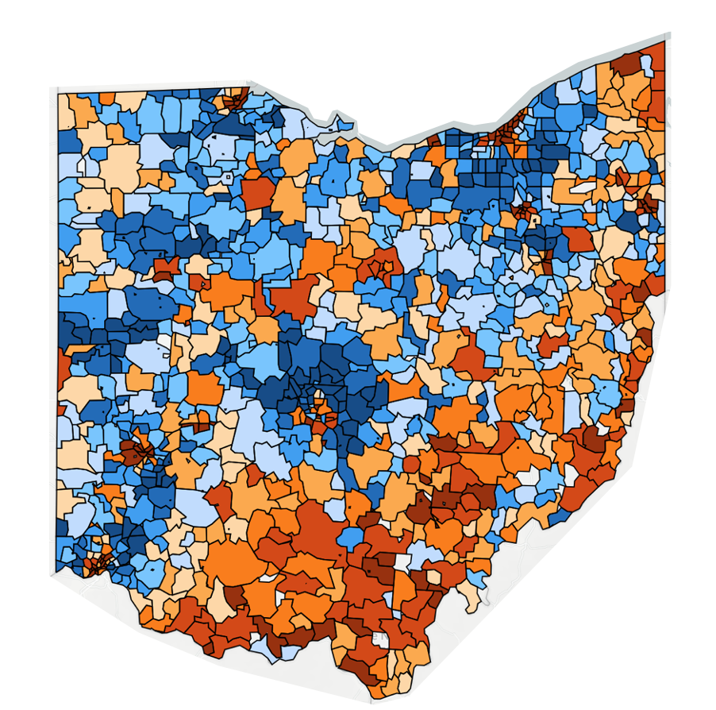
Eligibility
Meet at least one of the two criteria for consideration:
By Zip Code
Located in a distressed community
Owned by underrepresented populations
ECONOMIC INDICATORS:
Prosperous
Poverty rate
Median household income
Housing vacancy rate
High School
graduation rates
Adults 25-64 not working
Change in job growth
or decline
Change in the # of
business establishments
Comfortable
Mid-Tier
At Risk
Distressed

Slide 40
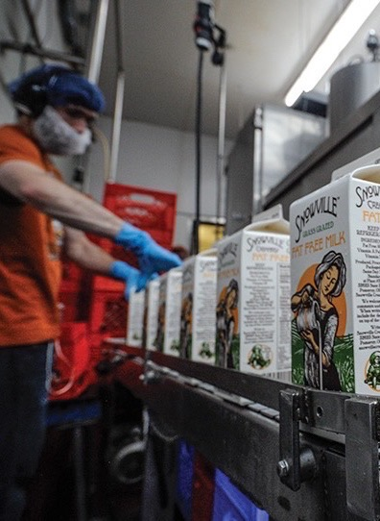
JOIG Program Highlights
Grants of up to $50,000 for small and medium-size companies investing to grow their business
  Business expansion or new facility investments
  New machinery or equipment
  Training of new or existing employees
Revenue cap of $25M annually to be eligible.
Employment or payroll growth of at least 10% as a result of the project.
New jobs must have a minimum average wage of $10.88/hr.
Demonstrated need for support to help the project move forward.
Must be in a JobsOhio targeted industry sector; retail or other population-based businesses are not eligible.
Company must have been in operation for at least one year before being eligible with annual revenues of at least $100,000.
Snowville Creamery Expands
Meigs County Production Facility

Slide 41
QUESTIONS?
slaybaugh@jobsohio.com
JobsOhio.com

