Slide 1
Surface Safety
Airfield Movement Areas
OHIO AVIATION ASSOCIATION
Christine Madden Deputy Regional Administrator (A) Great Lakes
August 23, 2021

Slide 2
Overview
Surface Safety – Best Practices
Construction ‘Tools’
Voluntary Reporting
Free Resources

Slide 3
Runway Incursion “any occurrence in the airport runway environment involving an aircraft, vehicle, person, or object on the ground that creates a collision hazard or results in a loss of required separation with an aircraft taking off, intending to take off, landing, or intending to land.”

Slide 4
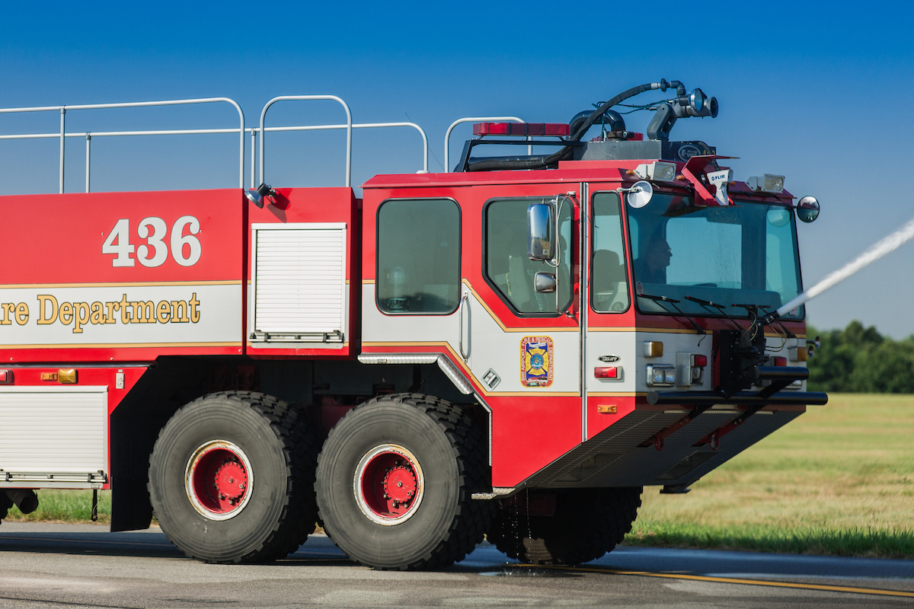
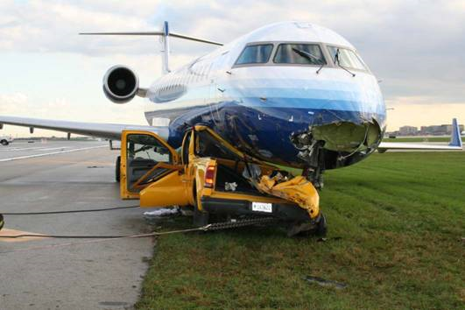
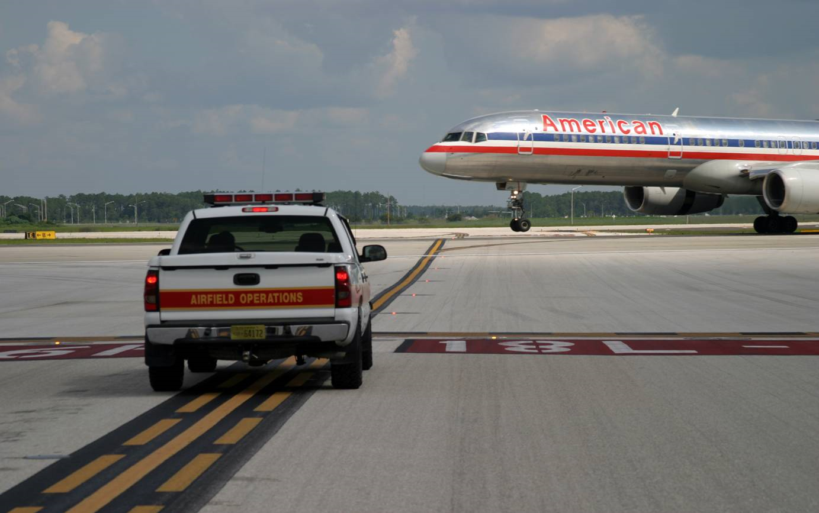
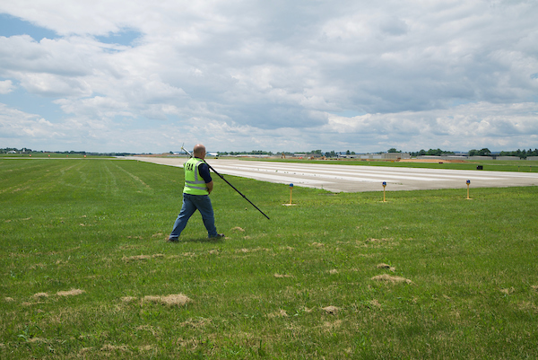
Vehicle/Pedestrian Deviations (VPDs)
Runway Incursions are grouped into Surface Events
A surface event caused by a vehicle driver or pedestrian on the movement area is a VPD
Notes:
Mowers, snowplows, ARFF, police, POVs, tugs, Ops, Aircraft Mx Taxi, i.e., an not intended for flight and it is necessary to reach out to air carriers and corporate facilities.

Slide 5
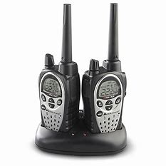
Best Practices Communication
Individuals have expressed that they are not comfortable talking to ATC
Training is essential!
Tips from FAA Office of Airports…
Notes:
Ensure airport operators, anyone with a need to drive or walk within the confines of the Runway Safety Area (RSA), has been thoroughly trained on signs, markings, lighting, phraseology, radio usage, reading an airport diagram, and both day and night operations.
Use of proper phraseology
Listen & reply to ATC

Slide 6
Best Practices Communication with ATC
Phraseology
ROGER is not a clearance
Actual Event – VPD occurred when an air traffic controller responded “ROGER” to a runway access request
Deviating from a clearance
If you request to cross a runway and see FOD along the way, prior to deviating, you must contact the Tower and request a new clearance to the area with FOD, as well as to exit the vehicle
Notes:
ROGER− I have received all of your last transmission. It should not be used to answer a question requiring a yes or a no answer.
Yes is AFFIRMATIVE and No is NEGATIVE

Slide 7
Best Practices Special Events, Airshows & Tenant Events
Recommend additional oversight by airport operator
Train personnel for special events and/or have additional staff on hand to provide escorts
Tenants bringing guests to hangar areas (i.e., for a BBQ) should provide a short safety briefing on where they can and cannot go

Slide 8
Best Practices Escorting
Ensure English Language Proficiency
Prior to escorting anyone on the airfield
Have a face to face conversation
Ensure that you can clearly communicate
Brief the individual being escorted to
Never pass the escort vehicle, even if they recognize their jobsite
Actual Event – a VPD occurred during an escort to the construction site when the escort vehicle was instructed by ATCT to hold short, however the vehicle being escorted recognized the job site and went around the escort vehicle, and crossed the runway without a clearance
Give a printed handout to those who you are escorting
Contact information for when they have to leave the site
A better practice is to stay with the person/vehicle being escorted

Slide 9
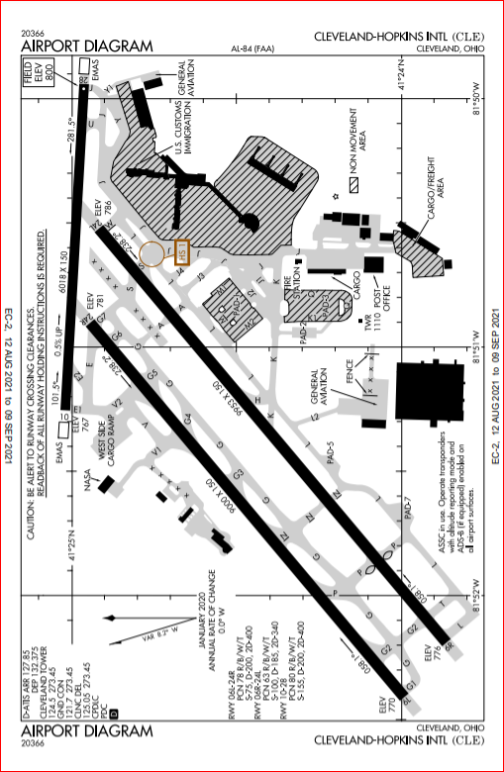
Best Practices Situational Awareness
Heads Up – Eyes Out
Eliminate Distractions
Use Airport Diagram
Listen to all radio calls
Be familiar with day & night operations
https://www.youtube.com/watch?v=gTc-SZi9nk8

Slide 10
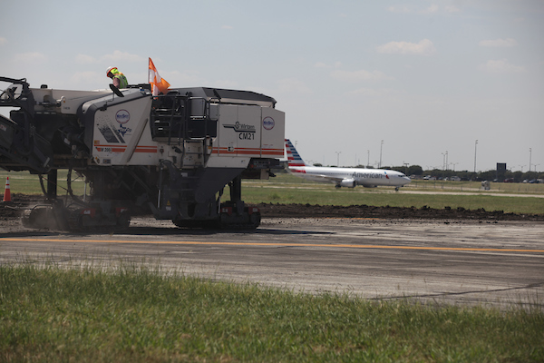
Best Practices Construction
Ensure all contractors & subcontractors are briefed
Provide oversight when haul roads or normally used service road routes change
Additional signage/personnel monitoring the change
Use numbered maps with the depicted haul route
Provide new maps when the haul route changes
Ensure all maps are returned from the old route
Notes:
Seasonal Tips – Construction
FAQs – Construction
CNDs – Currently this is a manual process. We expect to go to automated CNDs this Fall. Once this happens, an airport operator will need to use NOTAM Manager to create a CND when they enter a NOTAM into the system. If an airport is NOT on NOTAM Manager, they would not get a CND.
Runway/Taxiway Best Practices & Lessons Learned – a variety of airports provide information that is listed in this document.

Slide 11
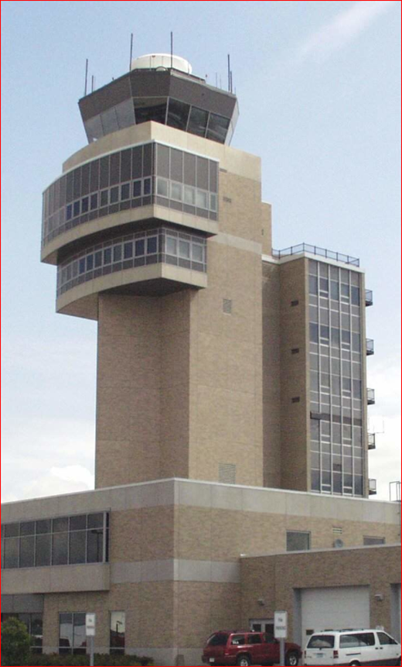
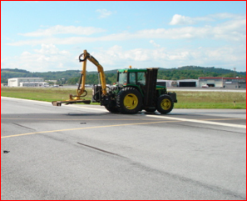
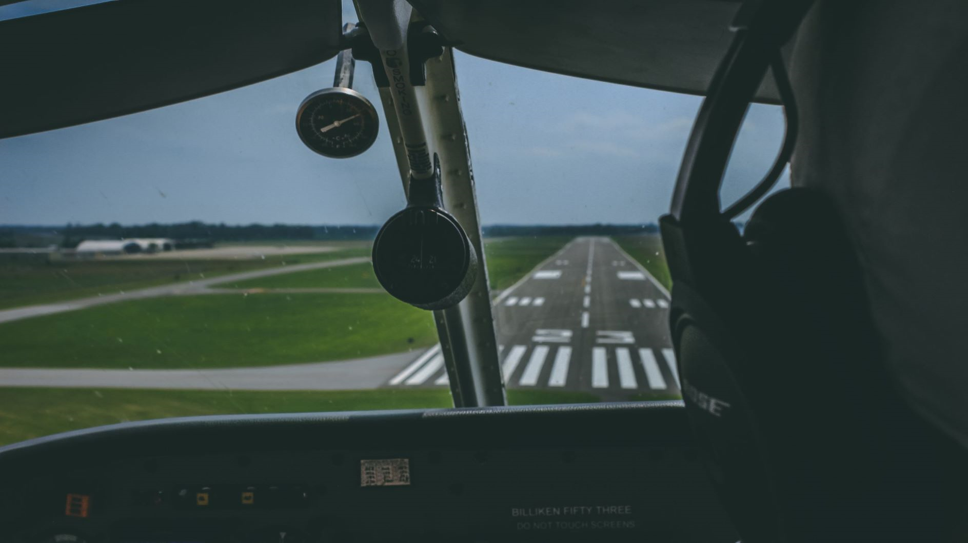
Notes:
August 3, 2008 at 1519 a Cessna Citation 550
Day (1519L), VMC, dry, both cleared to land/cross by ATC. Cessna Citation struck the tractor with the left wing approximately 10 feet inboard from the wing tip. The wing was torn from the aircraft resulting in an aircraft fuel spill and significant damage to the aircraft and the tractor. There were no injuries or fire.
file:///C:/Users/Christine%20Madden/Downloads/ATC%203%20-%20Factual%20Report%20of%20Group%20Chairman-Master.PDF

Slide 12
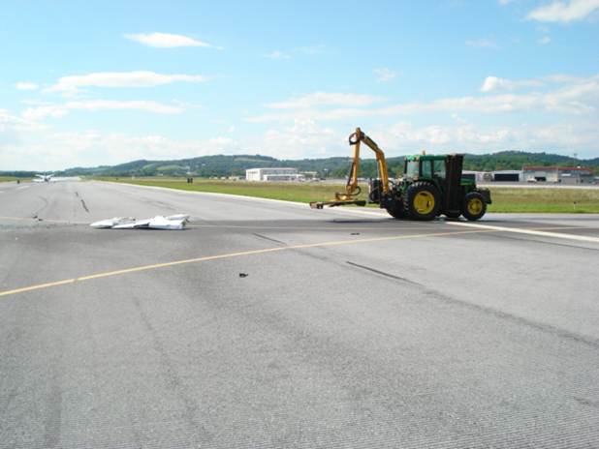
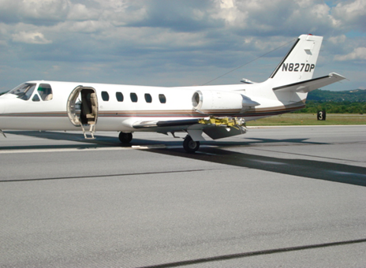
Accident…
Notes:
August 3, 2008 at 1519 a Cessna Citation 550
Day (1519L), VMC, dry, both cleared to land/cross by ATC.
Cessna Citation struck the tractor with the left wing approximately 10 feet inboard from the wing tip.
The wing was torn from the aircraft resulting in an aircraft fuel spill and significant damage to the aircraft and the tractor.
There were no injuries or fire.

Slide 13
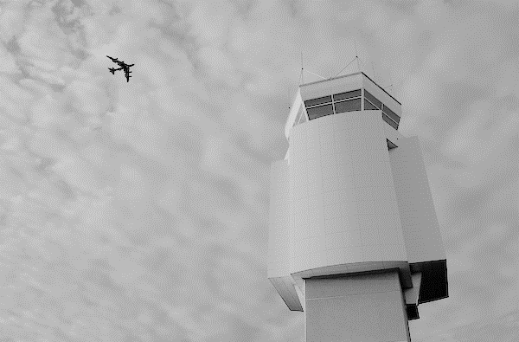
Airfield Safety - Towered & Non-Towered Airports
Training focal points:
Signs, Markings & Lighting (Day and Night)
Phraseology
Vehicle Walk-Around, Lights & Radios Working
Airport Diagrams (Frequencies/Route/Hot Spots)
Use Service Roads Where Possible
Eliminate Distractions
Heads Up – Eyes Out
Look Both Ways Before Crossing
Aircraft Landing Lights On? Likely Ready to Depart
Tips for a Towered Airport
Write the clearance
Understand the clearance
Clarify the clearance (if necessary)
Reply to the clearance
Know Light Gun Signals
Take radio when outside of the vehicle
Flash lights if radio is inoperable
https://www.faa.gov/airports/runway_safety/media/Ground_Vehicle_Guide_Proof_Final.pdf
Notes:
Day and night training
Signs, markings and lighting
Airport diagrams (frequencies, hot spots, construction)
Radio and lights are operational
Proper phraseology
Use service roads whenever possible
Eliminate distractions, i.e., cell phone, passengers, etc.
Heads up – Eyes out
Look both ways, ensure there is no conflicting traffic
Be aware that an aircraft with landing lights is ready to depart
ATIS

Slide 14
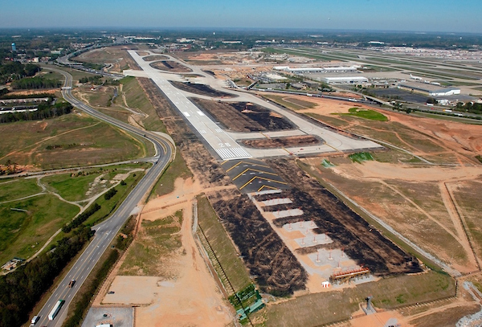
Construction
Seasonal Tips
Frequently Asked Questions
Construction Notice Diagrams
FAA NOTAMS
Runway & Taxiway Best Practice & Lessons Learned
Notes:
Seasonal Tips – Construction
FAQs – Construction
CNDs – Currently this is a manual process. We expect to go to automated CNDs this Fall. Once this happens, an airport operator will need to use NOTAM Manager to create a CND when they enter a NOTAM into the system. If an airport is NOT on NOTAM Manager, they would not get a CND.
Runway/Taxiway Best Practices & Lessons Learned – a variety of airports provide information that is listed in this document.

Slide 15
Construction Reminders
Collaborate – Communicate – Coordinate
Air Traffic Manager (if towered)
Airport Tenants
Airport Users
Notes:
Tell story about the airport operator who started construction on the airfield closing one of two runways, crossing runways. The longer runway was closed and airport tenants and users were unable to fly their aircraft into or out-of the airport. This can be avoided by communicating with your stakeholders, air traffic manager, tenants with flight departments, FBOs (transient aircraft).
Collaborate and communicate early and often, starting with the initial phase of project planning.
This concept may seem intuitive, however this happens often and it does not have to. Please consider impacts to the operation when planning construction projects. Success is hinged on collaboration, communication and coordination.

Slide 16
Runway Safety Action Team (RSAT)
Local RSAT is led by the Tower Air Traffic Manager (ATM)
Must include the ATM and Airport Operator, at a minimum
Involve personnel from FAA lines of business, airport tenants & users
Convenes at least once per fiscal year
Discuss topics related to surface safety
Review & update the Runway Safety Action Plan (RSAP)
Be Involved

Slide 17
RSAT Topics
Surface events
Mitigations
Construction
Hot Spots
Persistent weather issues
Action items
Best Practices/Lessons Learned
Wildlife
User concerns/feedback
Special Events
Letters of Agreement (LOA)/published notices
Notes:
We now have an RSAT Web Tool which provides a visual graphic of the locations of runway incursions, excursions,

Slide 18
How Do Pilots Get Information?
NOTAMs - Notices to Airmen
ATIS (Automated Terminal Information System)
Charting Publications
Hot Spots
Construction Notice Diagrams
Notes:
Thinking about the information that a pilot needs to know when flying in/out of the airport environment, not limited to surface safety. This point serves as a reminder to work with the Tower Air Traffic Manager to coordinate communications to the airport users.

Slide 19
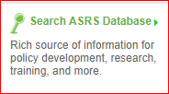
Reporting
Towered Airports
Mandatory Occurrence Reporting (MOR) process
Ensure you are notified immediately when a VPD is filed for airport operations personnel
Voluntary reporting is encouraged
Non-Towered Airports
Data is only collected via voluntary reporting
https://asrs.arc.nasa.gov/index.html

Slide 20
ASRS Examples
Light Transport Captain reported making a wrong turn during taxi at ### airport, citing poor signage as contributing.
Pilot reported a non-towered airport's publications and ASOS broadcast have not been updated to reflect a recent name change, with the inconsistency in naming causing NMAC events.
Reporter stated Taxiway A is not properly charted in the current NACO and Jeppessen diagrams and led to a Runway Incursion.
Tower Controller reported [multiple] aircraft having confusion with ### taxiways, resulting in frequent deviations from taxi instructions.
On approach with the FMS programmed and engaged. …GPWS [alerted] "too low terrain, pull up”…VMC with no terrain concerns. I am concerned that the top of the trees may be interfering with the approach clearance area. Also, taking off has resulted in a momentary GPWS warning when below 500 feet during climb.
Notes:
UAS sitings, signage issues, NOTAMS,

Slide 21
Outreach & Education - Drivers
FAA Runway Safety
Articles
Construction
Construction Best Practices_Lessons Learned User Feedback
Construction Notice Diagrams
Winter Ops
Videos
Situational Awareness
Phraseology – Coming soon!
Signage – Coming Soon!
FAA Summer Series - NOTAMS

Slide 22
Outreach & Education - Pilots
Free
Resources
FAA Runway Safety
From the Flight Deck Airport Specific and Single Topic Videos
Runway Safety Pilot Simulator

Slide 23
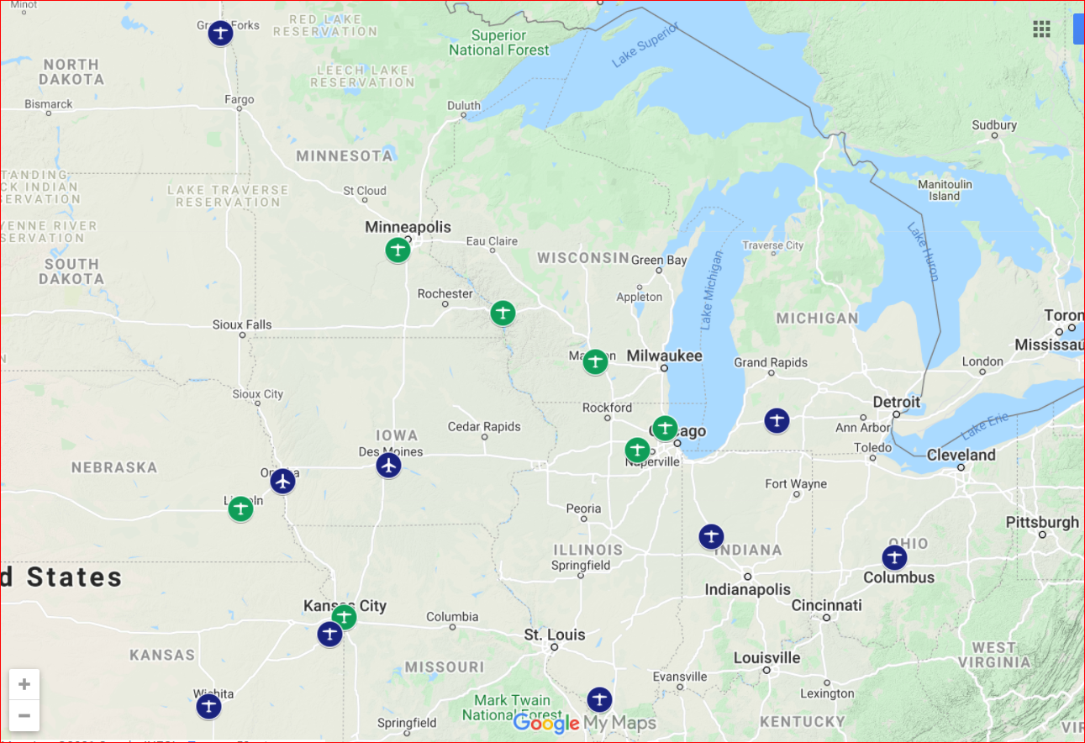
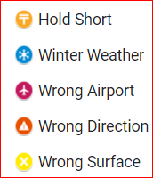
Outreach & Education Pilots

Slide 24
