Slide 1
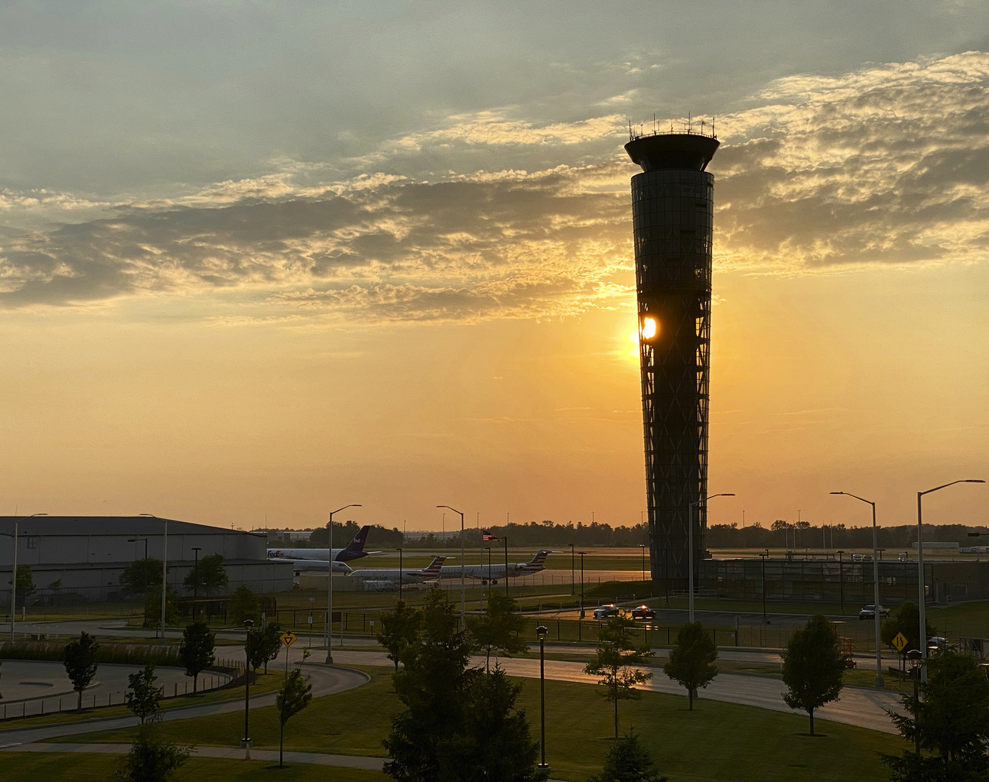
Asset Management for Airports
Jill M. Geboy
Aviation Strategic Consulting Market Leader

Slide 2
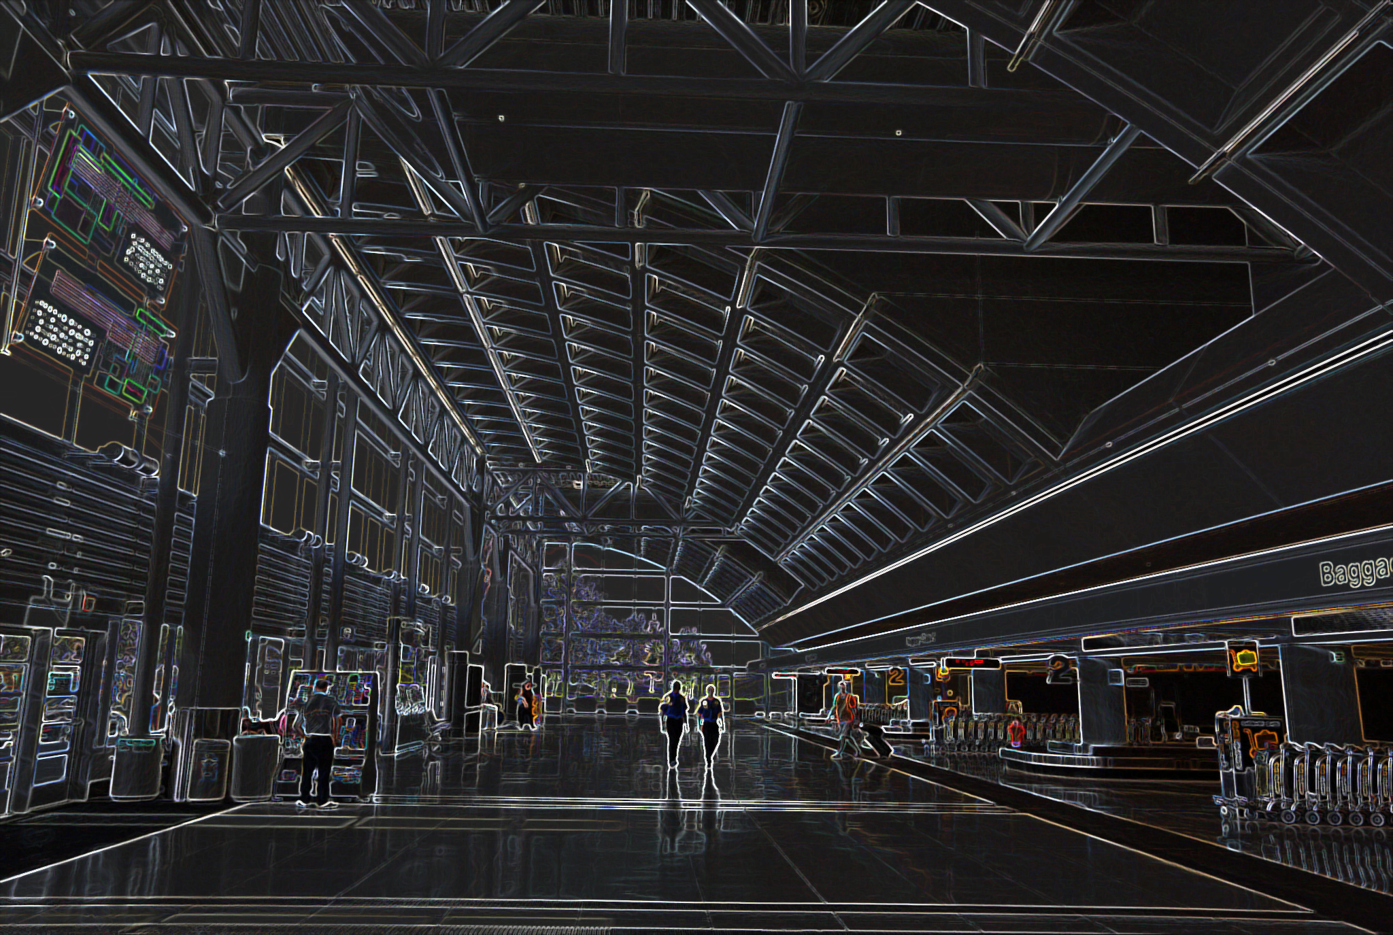
1. INTRODUCTION
4. ENTERPRISE AM
TECHNOLOGY
AGENDA
2. WHAT IS ASSET
MANAGEMENT?
5. PERFORMANCE BENEFITS
& LESSONS LEARNED
3. 10 STEPS OF AN ASSET
MANAGEMENT PLAN
6. QUESTIONS &
ANSWERS

Slide 3
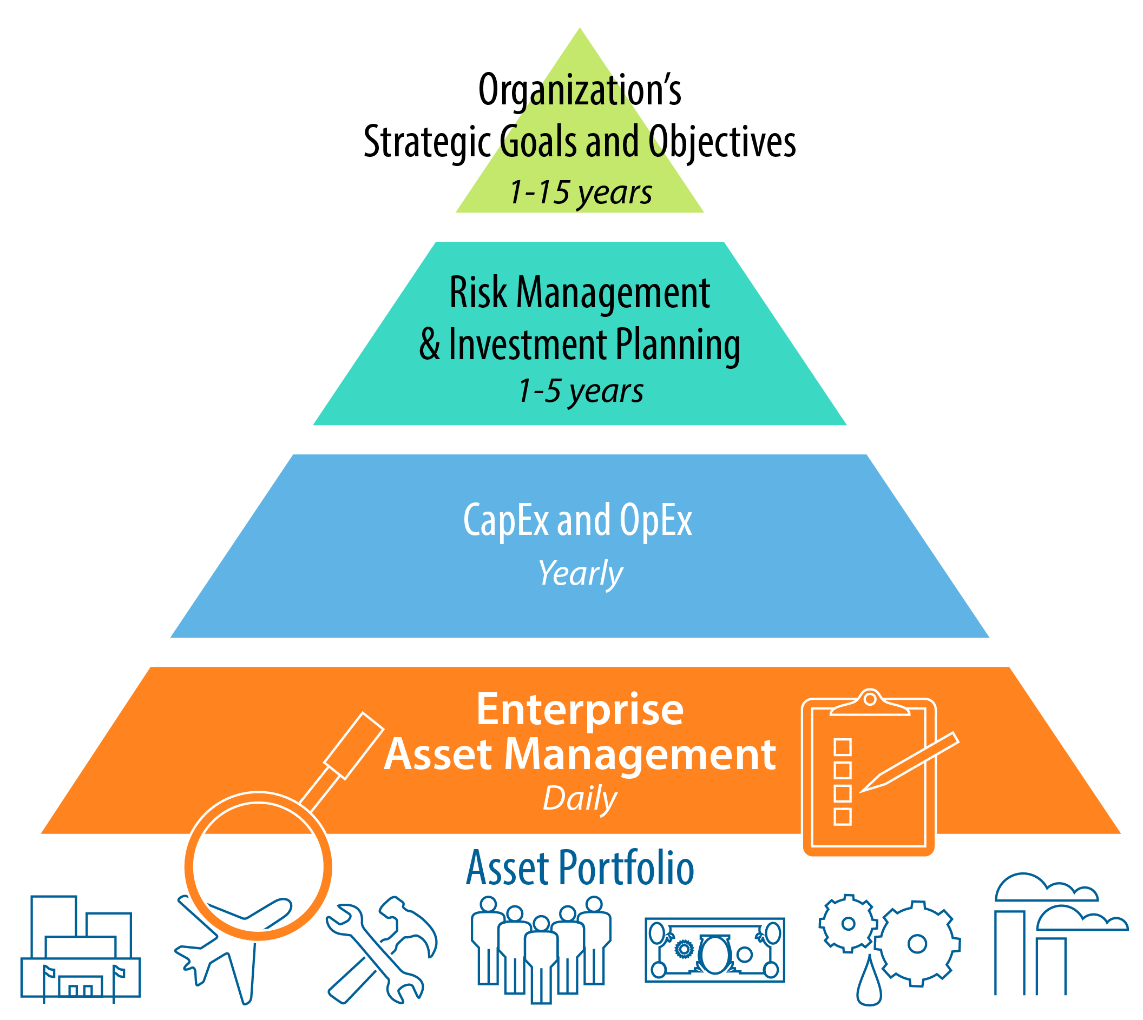
What is “Asset Management”?
“Realization of value involving a balancing of costs, risks, opportunities, and performance benefits.”
- ISO55000
Notes:
ISO 55000 is an international standard for the management systems. It establishes best practices and requirements for the design and deployment of an Enterprise asset management system. While it is not a requirement for any US agency to implement or obtain an ISO 55000 certification, achieving this compliance will enable an organization to make the move from reactive decisions to risk-based decisions.

Slide 4
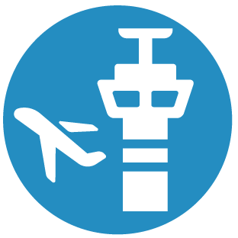
Asset Management Objectives
Airport business drivers
Effective Total Cost of Ownership
Maintain performance/Levels of Service
Improved passenger experience
Leverage and planning of CapEx and OpEx investments
Best practices
Standard “front end” contract documents
Proactive warranty documentation
Asset management tenets integrated into design process
Establish performance standards – code, regulatory, compliance
Outcomes/benefits
Reduces Total Cost of Ownership
Improves asset transition/turnover
Reduce overall risks
Reduction of asset downtime
Maximizes warranty consumption

Slide 5
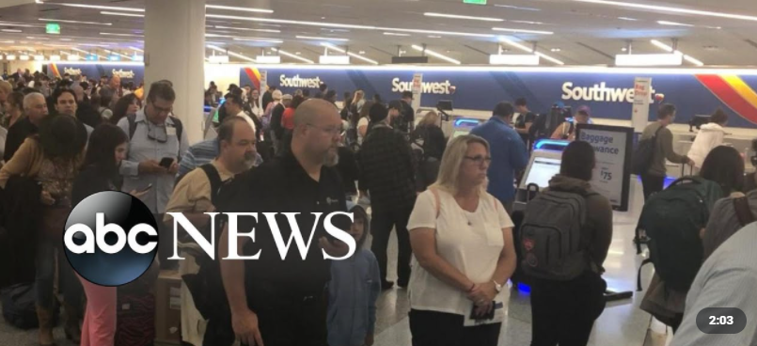
Impacts Due to Asset Failures
Decrease in overall passenger experience
Increased wait times
Delayed flights
Impacts to retail/concessions
Overcrowding
Safety/code Issues
Negative media coverage
“LAX Power Outages Cause Major Delays”
ABC News, June 6, 2019

Slide 6
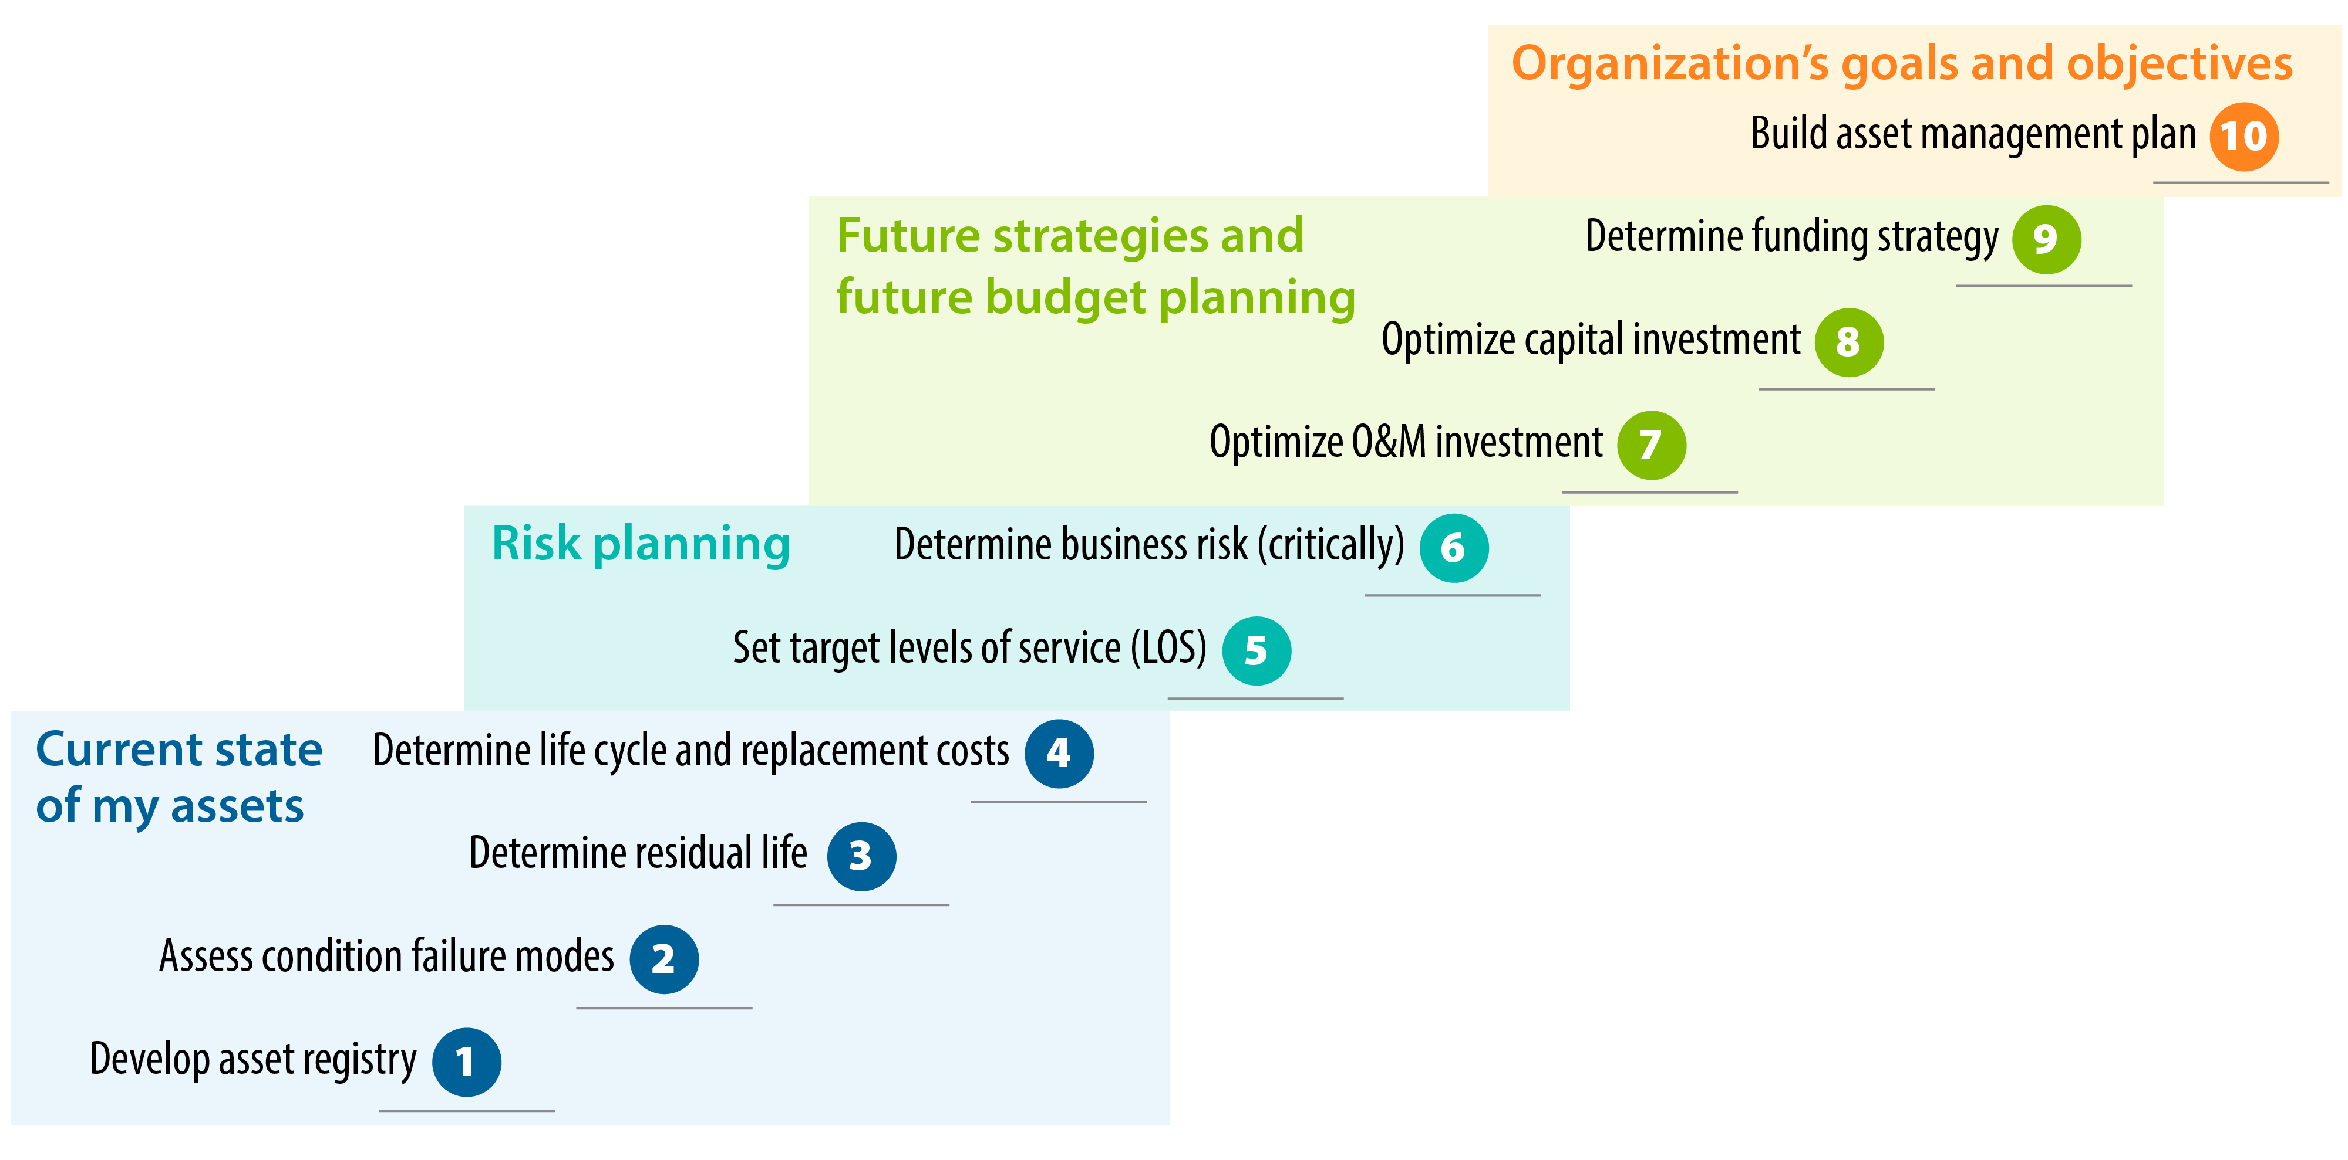
10 Steps to Developing an Asset Management Plan
Notes:
Especially in today’s world, Airport managers are constantly looking for more efficient and effective ways to manage infrastructure overtime. An AM Plan can be a tool to promote the efficient use of resources in a proactive, rather than a reactive, decision-making process.
If you’ve seen one airport, you’ve seen one airport. And no Airport AM plan is the same. Its unique to your specific organization and goals. Typically, at the beginning of this process a working group of airport staff are selected to participate in the development of an AM plan and to promote this new tool to other staff. Participants may include staff from operations, maintenance, finance, engineering, environmental, planning, and IT.

Slide 7
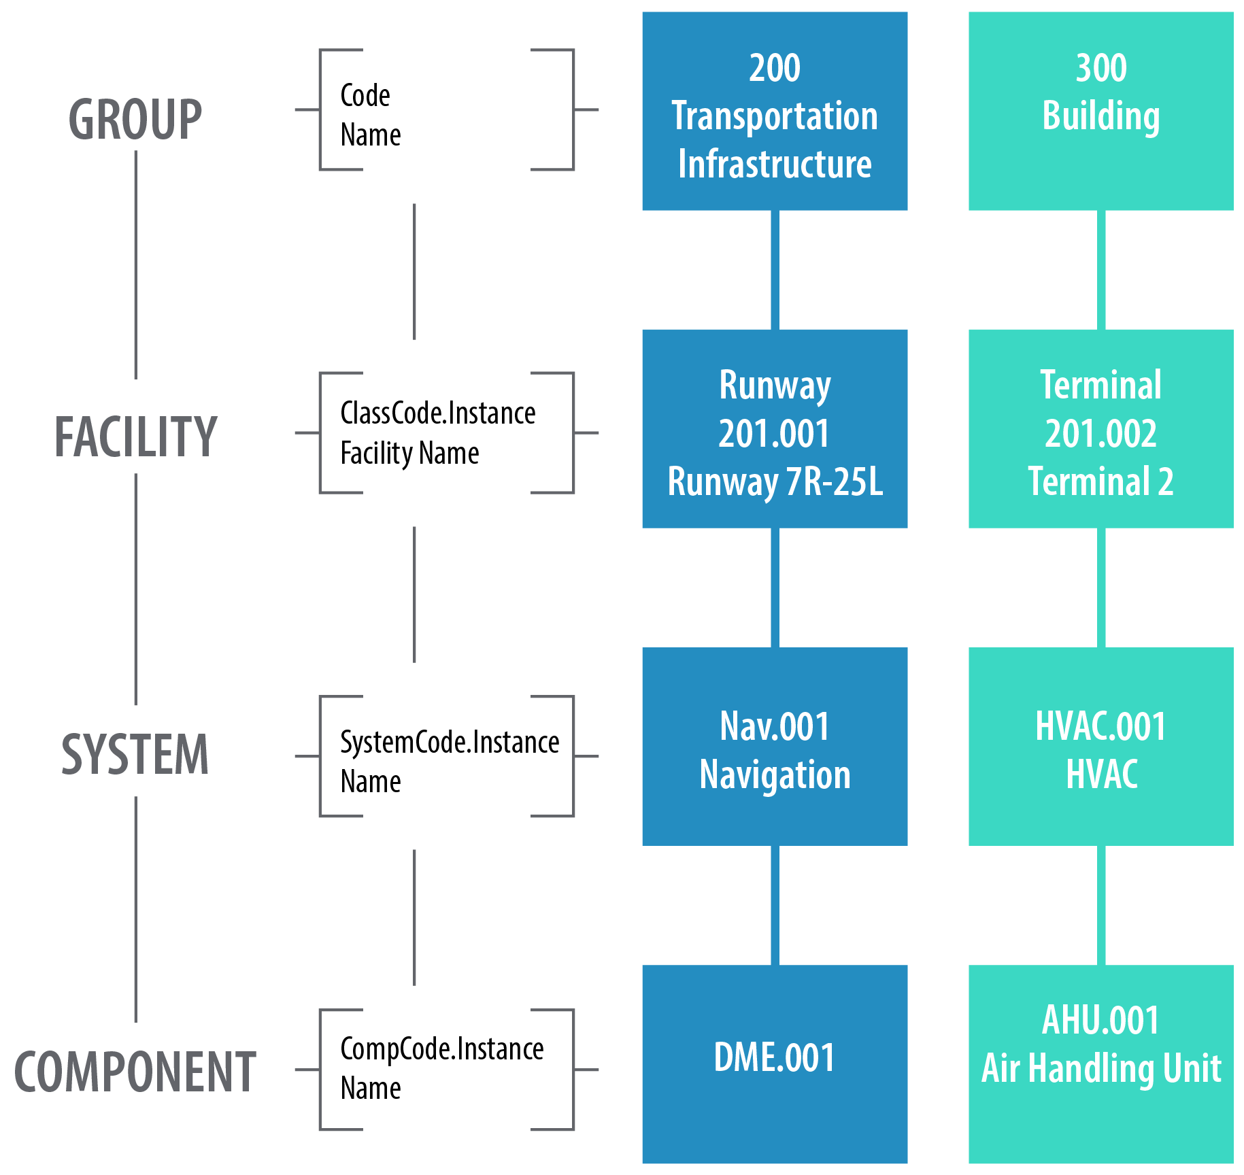
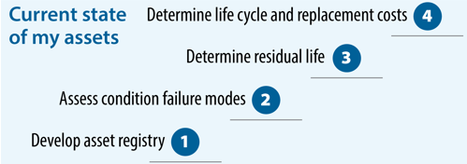
1-4: Current State of My Assets
QUESTIONS TO ASK:
Does the hierarchy structure align with the
functions of the business?
- Will the item be replaced individually?
- Is this a critical item?
Notes:
The asset registry is a database or spreadsheet inventory of all your assets within an asset group. This has a hierarchical logic associated with it so that its possible to evaluate the investment needs for individual assets. The level to which the hierarchy is built is typically to the maintenance managed item level – which is the level at which work orders will be written. Asset components are not typically included unless are deemed as critical or of high value. In this example, Level 1 is an independent system, and Levels 2 and 3 are dependent systems.

Slide 8
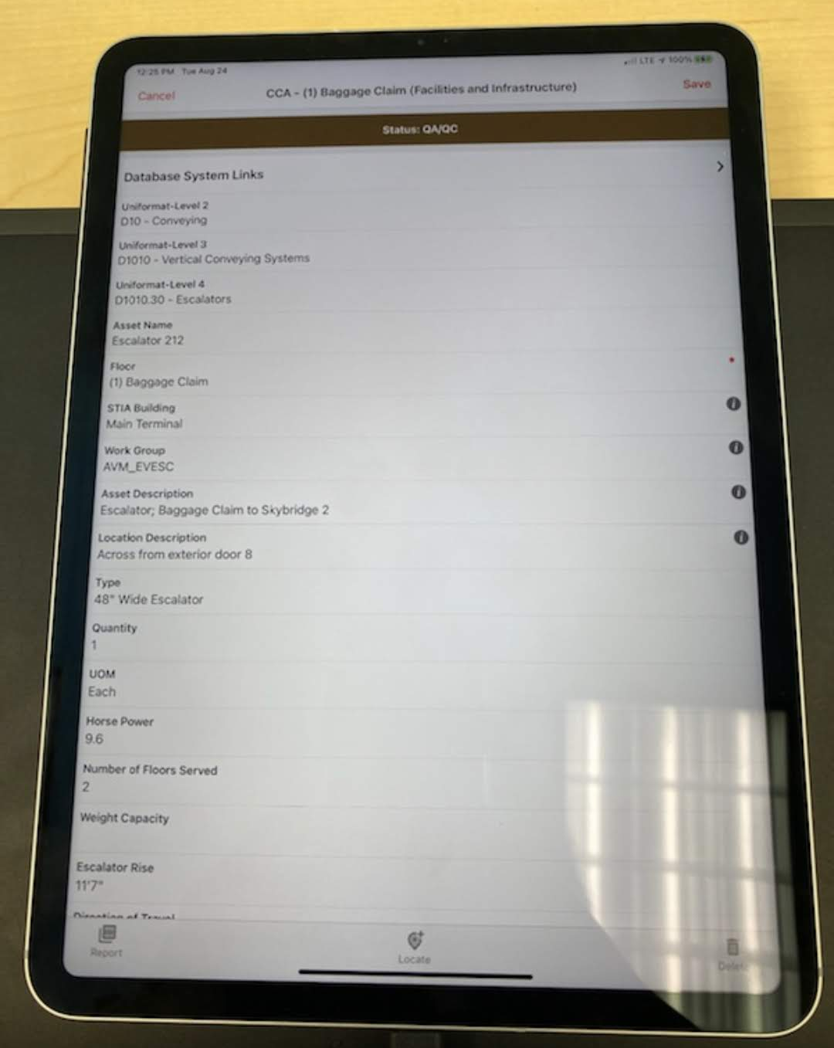
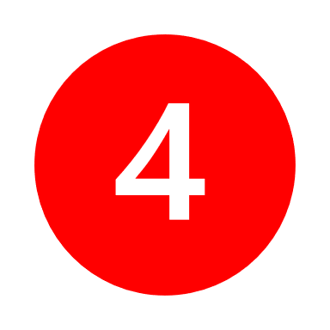
Condition Assessments
QUESTIONS TO ASK:
What assets do I own and maintain?
How old are my assets?
When should I replace my assets? (run to failure or do corrective and preventive maintenance).
Condition Score | Description
 | New or Excellent Condition
 | Minor Defects
 | Moderate Deterioration
 | Significant Deterioration
 | Virtually Unserviceable
SEA Condition Assessment with GIS Component
Notes:
Condition Assessments serve two purposes – (1) to identify the maintenance and rehabilitation needs and (2) to monitor the health of the asset network. Looking at asset condition and defects – everything from HVAC equipment, lighting, restrooms, flooring, roofing, airfield assets, etc. During this process we also look at any existing maintenance data history and as-builts and document size and potentially the location of assets (if there is a GIS feature) in the EAMS.
Often times, assets do not always reach their design life, or they can sometimes exceed their design life due to a number of factors including:
Operating the asset at a level not intended during the design phase
Human factors
Operating environment
Maintenance type and frequency

Slide 9
Steps 5-6: Risk Planning
Establish Levels of Service:
Determine Asset Criticality (Risk):
Review contract agreements with operations and maintenance service providers.
Determine if there are regulatory requirements.
Establish KPIs and targets.
Availability (must operate 24 hours per day/7 days per week or other.
Reliability (must not fail)
Condition (must be maintained at/not less than a condition rating of 2)
Throughput/output
Risk Exposure =
Probability of Failure x Consequence of Failure
Notes:
Levels of Service - There are several different KPIs (key performance indicators) you may want to consider when establishing a LOS. For example, one KPI could be quality and the LOS would be to provide a well-maintained safe and efficient airport. Another could be cost effectiveness and to provide appropriate airport facilities in a cost-effective manner. And you would measure your overall future performance based off of how your airport is currently operating compared to after an EAMS is set up. Going with our example, your set performance target may be to reduce maintenance cost by 10%/year or to decrease overall asset downtime by X hours.
Criticality – this step identifies the critical assets, which are assets that are high in cost and/or result in detrimental levels of service and significant consequences if they fail.
The key objective is to work toward the most achievable tradeoff between level of service, costs, and risk exposure. (use car example) and establish specific and measurable goals

Slide 10
Steps 7-9: Future Strategies & Budget Planning
Renewal Decision Making:
Funding Strategies:
Do nothing?
Maintain differently?
Operate Differently?
Repair the asset and when?
Replace with a similar asset?
Replace with an improved asset (considering environmental factors)?
Reduce the level of service?
Increase risk?
Bond Financing
AIP Funding (FAA Airport Improvement Program)
Passenger Facility Charges (PFC)
Operations & Maintenance Budget
1-5 YEAR Funding and Investment Plan
5-10 YEAR Funding and Investment Plan
Notes:
Now we take what we have delivered/found in steps 1-6 to then evaluate the best operation, maintenance, and capital investment strategies needed to deliver the established LOS at the best cost and level of risk.
From level 2 – looking at what assets are due for renewal and when (1-5 years, 5-10 years).
Review our renewal options for each asset.
Develop a budget estimate for the asset renewals.
Use the residual life of the asset as determined from the condition assessment as the timing for the investment
Assess asset total cost of ownership
Determine the best funding strategy

Slide 11
Total Cost of Ownership
Total Cost of Ownership (TCO):
Is a financial estimate intended to help owners determine the direct and indirect cost of an asset in order to make repair-or-replace decisions. Implementation of TCO principles can help clients improve decision making and maximize financial strategies over the life of an asset
Notes:
From the condition assessments we have determined the replacement costs of the assts, the current maintenance costs of each asset and if it is likely to increase as the asset ages, determining the cost of operation (this could be labor, energy consumption) and if that is likely to change throughout the assets life, and estimate future maintenance and operating costs.

Slide 12
TCO Savings

Slide 13
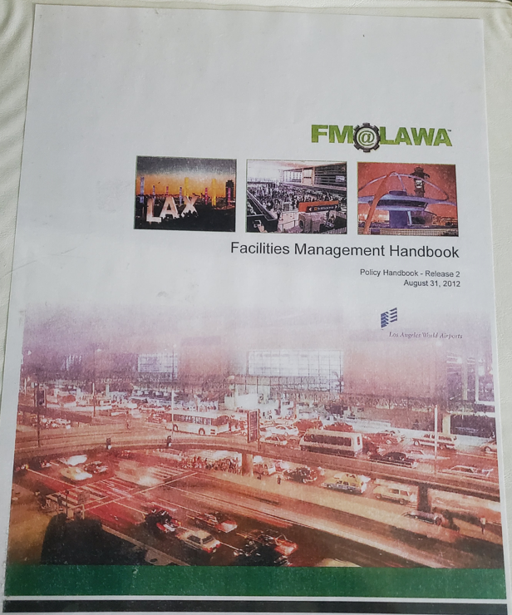
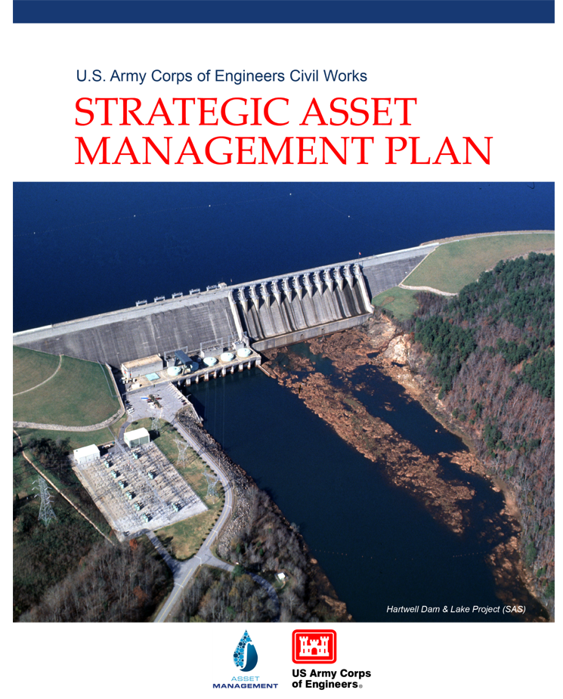
Step 10: Build Asset Management Plan
Asset Management Plans Typically Contain:
Overview of facility/system or network of assets
Established Levels of Service
Established list of critical assets
Strategies and investments to close performance gaps
Renewal Plan
Demand and growth forecasts
Capital plan (new assets)
10-year infrastructure investment plan
10-year funding plan
Business improvement plan
Challenges for implementing the plan and mitigations
Human resource requirements

Slide 14
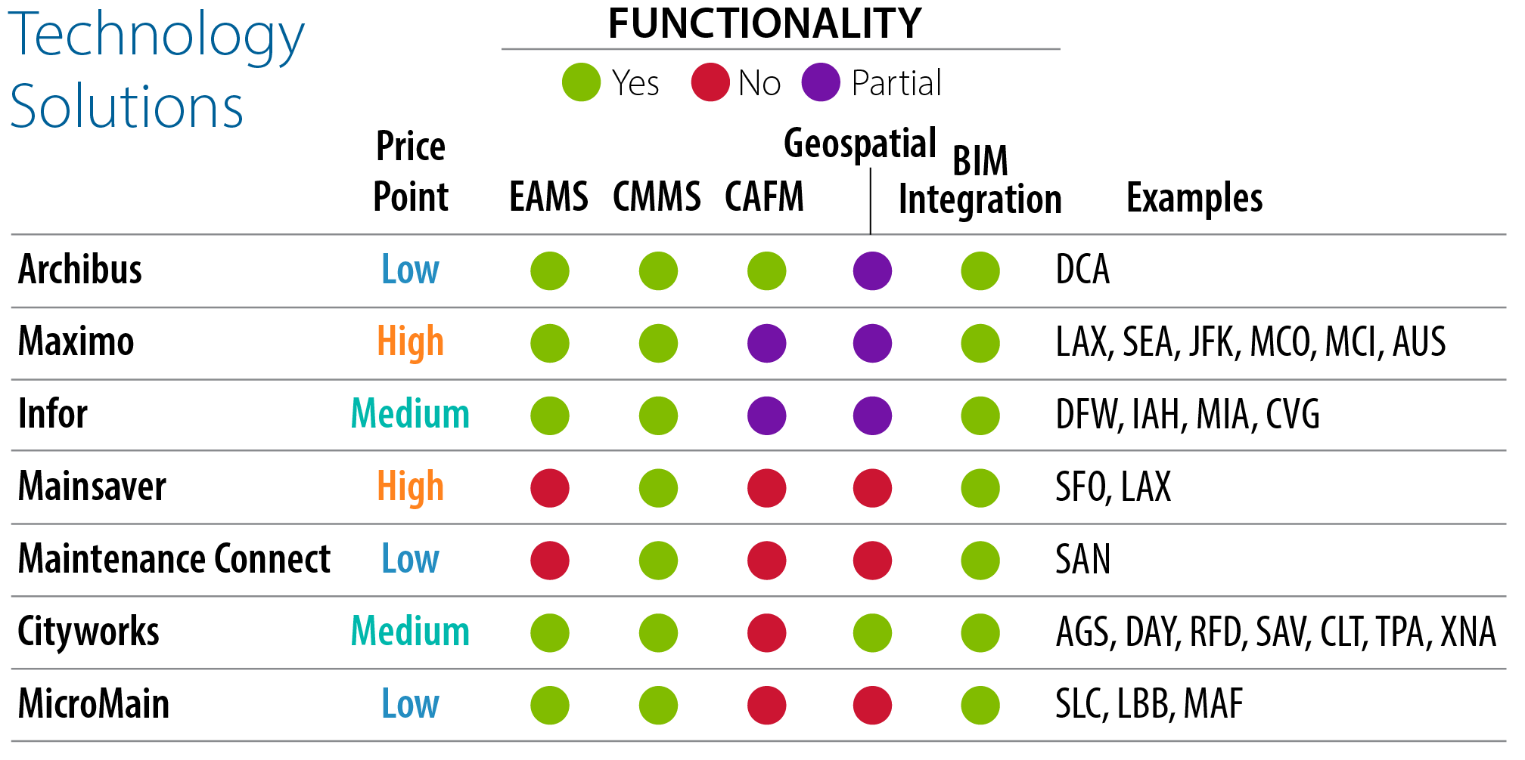
EAMS: Supporting Technology
Technology alternatives
Best of breed
Integrated solution
EAMS vs. CMMS vs. CAFM
Design considerations
Technology architecture approach
Integration with financial systems (GASB 34 requirements, etc.)
Role of the system (inventory, maintenance, 3rd party contractors, condition)
Types of assets (vertical, linear)
Notes:
EAMS = Enterprise Asset Management System
CMMS = Computerized Maintenance Management System – focuses only on maintenance operations / work orders
CAFM = Computer Aided Facility Management – space and workplace management and use of real estate
Mobile Component

Slide 15
Data Linkages: Current State

Slide 16
Challenges / Lessons Learned
Sr. Leadership Support From Beginning
Establish a Leadership & Governance Structure Early
Be Clear About What the Airport Wants to Achieve
Maintenance Staff May Feel Like “Big Brother is Watching”
Ensuring Uploaded Information in Accurate
Training Staff to Use the EAMS Properly

Slide 17
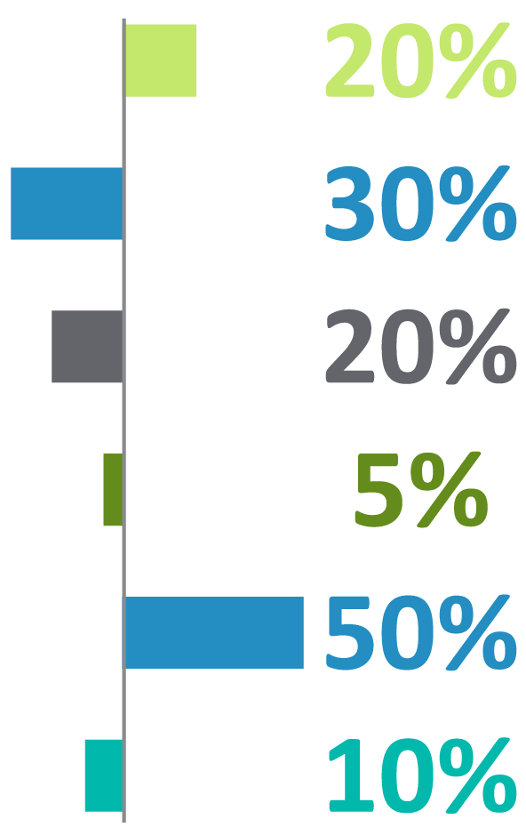
Recorded EAMS Performance Benefits
Improvement in labor productivity
Reduction in inventory levels
Reduction in inventory carrying costs
Reduction in new equipment costs
Increase in warranty cost recovery
Reduction in materials costs

Slide 18
Thank You
JILL GEBOY
Email: jill.geboy@woolpert.com
Cell: (937) 844-3773

